Slide 1

Preoperative Total Joint Replacement Education
Stacey Wood, BSN, RN, ONC
Joint Program Clinical Coordinator
Orlando Regional Medical Center
Revised 2/2/21
Notes:
Welcome and thank you for choosing Orlando Health for your upcoming joint replacement.

Slide 2
Disclaimer
This class will help prepare you for your total joint replacement surgery by providing some helpful information. The intent is not to replace any information your surgeon has given you about your procedure. Your surgeon, therapist or nurse may add to or change some of the recommendations based on your personal needs. If you have questions about your specific surgery, please contact your surgeon.

Slide 3
Begin planning for your surgery now!
Select a caregiver that can physically assist you with the following items:
  Be able to stay with you 24 hours/day for the first few days
  Drive you to your follow up appointments
  Assist with your recovery exercises and dressing changes
  Assist with household chores (cooking, laundry, cleaning, grocery shop, yard work, pet care, etc)
Notes:
Make plans for someone to stay with you after surgery until you can move around safely.
Arrange for someone to collect your mail, help with household chores, and drive you to your follow up appts.
You may want to make or buy meals in advance that may be frozen and easily reheated.

Slide 4
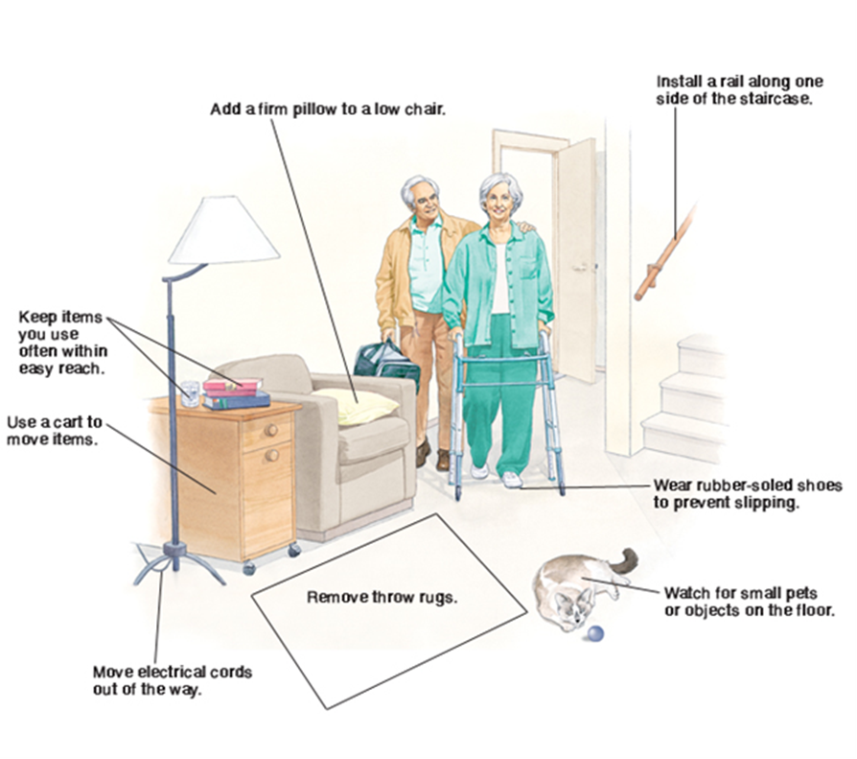
Prepare Your Home
© 2000-2008 The StayWell Company, 780 Township Line Road, Yardley, PA 19067. All rights reserved. This information is not intended as a substitute for professional medical care. Always follow your healthcare professional's instructions
Notes:
Ask family or friends to move any furniture that would prevent you from comfortably moving around with your walker.
Clear tripping hazards (throw rugs, electrical cords and small toys) from your pathways.
Choose a chair, preferably with armrests, which is comfortable and easy to get in and out of.
You may stack seat cushions, firm pillows/blankets on low seated furniture which will provide an elevated seat.
Place a small table next to your chair so you can easily reach the items you may need such as a phone and remote control.
Consider how you will be entering your home. Do you have to climb any steps? Is there a hand rail for you to use for support? If not, consider installing one.

Slide 5
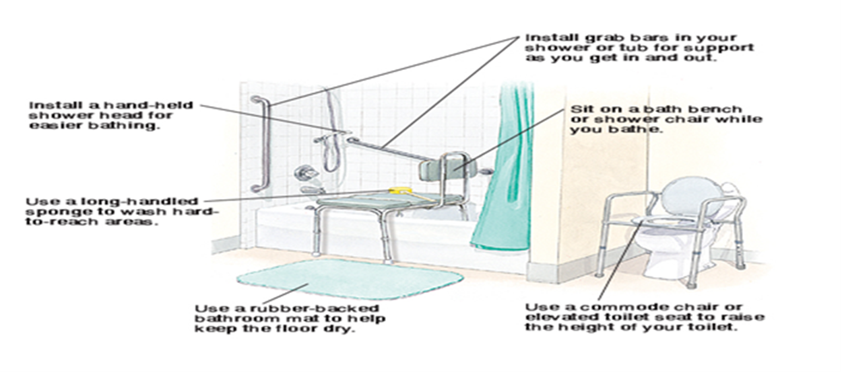
Prepare Your Home
© 2000-2008 The StayWell Company, 780 Township Line Road, Yardley, PA 19067. All rights reserved. This information is not intended as a substitute for professional medical care. Always follow your healthcare professional's instructions.
Notes:
Use a rubber backed bath mat to prevent a slip and fall
If you do not have grab bars or a hand held shower head consider installing them
A bath bench and commode chair are helpful when showering and using the commode.
And a long handled sponge can make those hard to reach areas (lower legs/feet) easier to wash

Slide 6
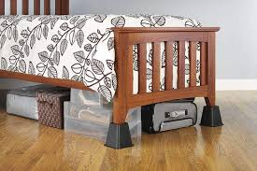
Prepare Your Home
Use nightlights to improve visibility for nighttime toileting
We recommend that someone help you move your essential cooking, bedroom, and bathroom items to waist height to make them easier for you to access.
Look at the height of your bed, adjust if too high or low
  Too high remove the frame or feet
  Too low add bed risers/blocks
Notes:
Install nightlights in hallways, bathrooms, and bedrooms to improve nighttime visibility
Put often used items on an easy-to-reach shelf or surface that is waist-height or above.
A bed that is too high or too low will be hard to get in/out of after surgery.
Bed risers are made of wood or a heavy duty plastic and elevate a bed. They are placed under bed posts and can be found at home improvement stores.
If you live in a two story house, you may want to move a bed and any essential items to the first floor.

Slide 7
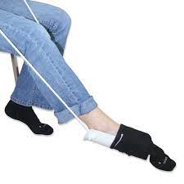
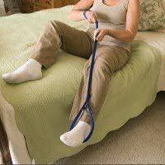
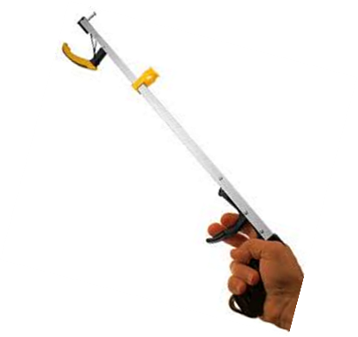
Home Equipment
You may wish to purchase adaptive equipment prior to surgery to help you with your recovery.
REACHER/GRABBER
SOCK AID LEG LIFTER
Notes:
Adaptive equipment such as sock aids, reacher/grabber, and leg lifter can be helpful and provide independence during your recovery.
A sock aid is an assistive device that allows you to put on your socks more easily despite pain and physical limitations.
Grabber is a handheld tool used to increase the range of a person's reach when grabbing objects. It can pick items up off the ground and assist you with getting dressed
Leg lifter is designed to aid patients in getting in and out of bed, by offering additional support in lifting one, or both, of their legs.
These items are not covered by insurances but can be purchased at your local medical supply storm or online.

Slide 8
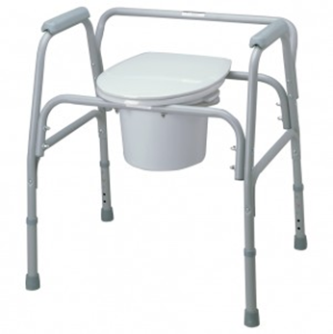
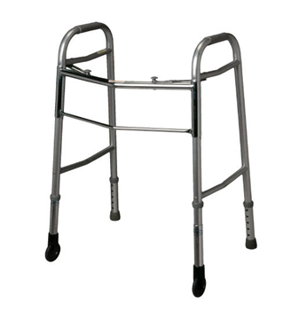
Home Equipment
Rolling Walker
Elevated Commode
If your insurance doesn’t cover these items, they can also be found at :
Stepping Stones, 407-649-4100, Mon-Fri 8am-4pm
Any Medical Supply Store
Local Salvation Army or Goodwill
WWW.Amazon.com
Notes:
An elevated commode and 2 wheeled walker are recommended for your recovery

Slide 9
Preparing for Surgery-Know your Insurance Benefits!
Insurance does not consider living alone a reason to go to a rehab or a skilled nursing facility (SNF) and may not pay.
  Consider family members, neighbors, or friends that could help you at home.
  Discuss your living situation with your surgeon.
Statistically, going to a SNF increases your chance of developing an infection, falling, or being readmitted to the hospital for a complication.
If you must go to a SNF, verify your coverage with your insurance company so you are aware exactly what they will pay for.
Notes:
Know your benefits!
If you live alone insurance companies do not consider that a reason to go to a rehab or SNF.
Discuss your living situation with your surgeon.
If the plan is to go to a rehab, call your insurance to determine if you will have a deductible or co-payment to meet.

Slide 10
Preparing for Surgery-Know your Insurance Benefits!
Call your insurance company and let them know you are having a joint replacement. Find out if the following items are covered under your plan:
  Home Health Nurse
  Home Health Physical Therapist
  Front Wheeled Rolling Walker
  Elevated Commode, also known as a 3-in-1 commode
Notes:
Patients discharging home may have a home health nurse/physical therapist set up your first few weeks at home.
Call your insurance company to determine if you will have a copayment with these visits
Also, is the walker and elevated commode fully covered under your plan or will you have a co-pay or percentage you will be responsible for.
It’s important to plan for any out-of-pocket expenses.

Slide 11
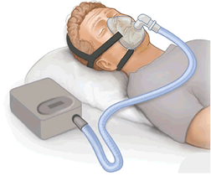
What to Bring to the Hospital:
Comfortable, loose-fitting clothes and non-skid shoes. These must fit over a swollen and bandaged leg.
Glasses, dentures, and hearing aids if needed.
Hygiene items if preferred (toothbrush, toothpaste, deodorant).
Please do not bring your own medications to the hospital. We will already have a record of your medications from your preadmission testing visit.
Leave valuables at home (jewelry, purses, computers, etc).
If you have sleep apnea and use a C-PAP or Bi-PAP machine,
we will ask you bring it with you to the hospital to use after surgery.
Notes:
Bring or wear comfortable, loose-fitting clothes and a non-skid shoe. No flip-flops or slides
You do not need to bring in any of your medications from home but we will ask that you bring your CPAP or BiPAP machine if you have sleep apnea.
Continue to use your CPAP/Bipap after discharge to maintain adequate oxygenation, especially while taking pain medication.

Slide 12
Prepare your body for Surgery

Slide 13
Good Preparation leads to a Great Outcome!
Your body will undergo some stress with this surgery. Now is the time to prepare!
In the same way an athlete would prepare their body to run a marathon you should prepare your body for the surgery.
Preparation should include:
  A healthy diet
  Hydration (plenty of water)
  Exercise
  Smoking cessation
  Diabetes management
  Preoperative showers
Notes:
Your body will undergo some stress with your surgery.
Ways to help your body recover are through a heathy diet, staying hydrated, exercising, stop smoking as soon as possible, keeping blood sugars under control, and keeping your skin clean.

Slide 14
Begin with a healthy diet…..
Good nutrition is essential to a good outcome. Begin today eating a well-balanced diet before and after surgery.
A healthy, well balanced diet includes:
  High quality, lean proteins, fresh fruits and vegetables, and whole grains (high fiber breads and cereal products)
Increase protein intake to help with wound healing
  Consume at least 1 gm of protein per 2 pounds of body weight, unless you doctor has told you otherwise.
  Eggs, nut butters, beans, meat (poultry and/or fish), tofu, and dairy products are good protein sources.
www.myplate.gov is a great source for dietary guidelines
Notes:
Good nutrition is essential to a good outcome.
Maintain a balanced diet of fresh fruits/vegetables, whole grains and lean proteins.
Protein in particular helps the wound heal.
If you have any dietary restrictions, please continue to follow your physicians' guidelines
1 oz meat ~ 7grams of protein; 3 oz meat=21 oz protein

Slide 15
Hydration is very important
Stay well-hydrated before and after surgery by drinking at least 8-10 glasses of non-caffeinated fluid (such as water) daily, unless your doctor has told you otherwise.
Why?
  Patients that are well hydrated before surgery…..
    Have veins that are easier to find for your IV site
    Have less nausea and vomiting after anesthesia
    Have more stable vital signs during anesthesia
    Heal faster and feel better
Notes:
Water is important to the body. It helps maintain proper blood volume, controls body temperature, helps remove toxins & waste and prevent constipation.
It is recommended to drink 8-10 glasses of water per day
Caffeinated beverages should be taken in moderation to prevent dehydration

Slide 16
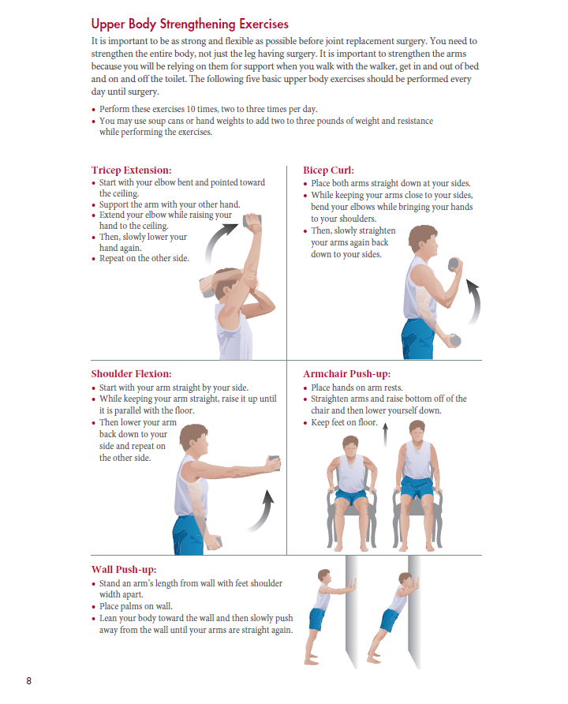
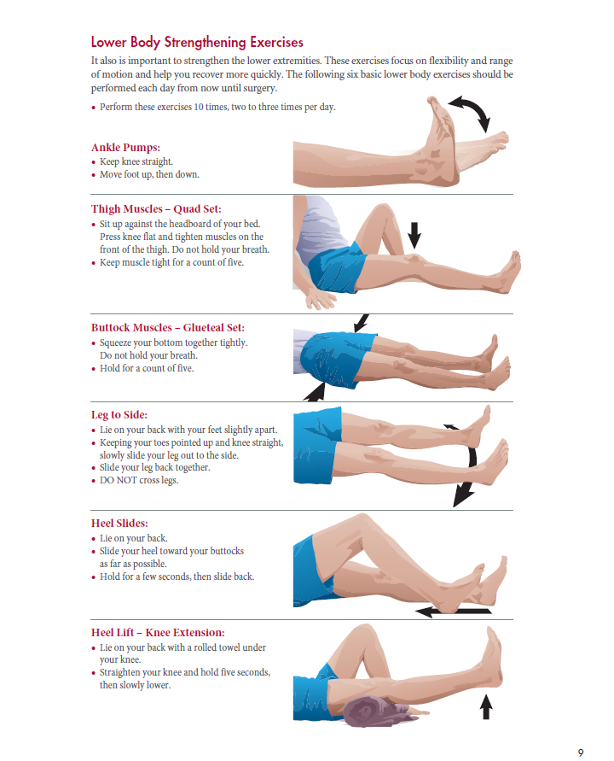

Preoperative Exercises (pages 8 & 9)
Notes:
Exercising before surgery has many benefits.
Studies show that patients who have exercised prior to surgery have more successful outcomes than those who don’t exercise.
On pages 8 & 9 of the joint replacement surgery booklet are some upper and lower body exercises.
For your upper body--It is important to strengthen your arms because you will rely on them for support when you walk w/the walker, get in/out of bed and on/off the toilet.
The lower body exercises focus on flexibility and ROM and help you recover more quickly.

Slide 17
Smoking and Surgery
Studies have shown that smoking:
  Reduces blood supply to bones, muscles, joints and other tissues in the body.
  Slows bone healing, the risk of bone not healing is almost 4 times greater among smokers than nonsmokers.
  Increases the risk of surgical site infections—smokers' risk of infection are more than double those of nonsmokers.
  Increases risk of respiratory complications after surgery prolonging hospital stay.
  Increases risk of developing blood clots and elevating blood pressure after surgery.
Notes:
Smoking impedes/interferes oxygen circulation and delays healing.
It may also increase your risk of developing blood clots and an infection, as well as effect your BP and HR
The nicotine in tobacco products slows healing and increases your risk of these complications so it is very important to stop smoking before surgery.

Slide 18
Managing your Diabetes
Diabetes can increase your risk of developing a complication after surgery. If uncontrolled, it can cause your wound to heal slowly or get infection.
Keeping your blood sugars well controlled can greatly reduce these risks
Once you have discharged from the hospital continue to manage your diabetes by:
  Checking your blood sugars as ordered by your physician
  Take diabetic medications and/or other treatments as prescribed by treating providers
  Maintain a healthy diet
  Stay hydrated
  Exercise, when cleared by physician
Notes:
Diabetes can increase your risk of developing a complication.
High blood sugars make you more likely to develop an infection by delaying the healing process.
Continue to follow your physician’s diabetic recommendations after surgery to keep your blood sugars in the range that has been set for you.

Slide 19
Preadmission Testing Appointment
Your surgeon's office will schedule this appointment about 1-2 weeks before surgery.
  This appointment usually takes between 2 to 3 hours.
  It will consist of blood work and tests (EKG, x-ray, urinalysis, etc.).
  These tests help your doctor look for health problems that may need to be addressed before your surgery.
  You will meet with someone from anesthesia team.
Please bring the following information to your appointment:
  Picture identification (such as drivers license)
  Your insurance card
  Complete list of all your medications
  Copies of any surgery clearances and/or recent medical tests you may have had done.
  Copy of your living will or power of attorney (if you have them)
Notes:
Read slide

Slide 20
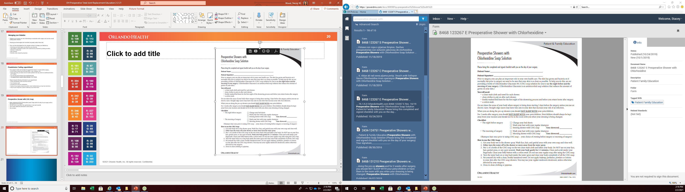
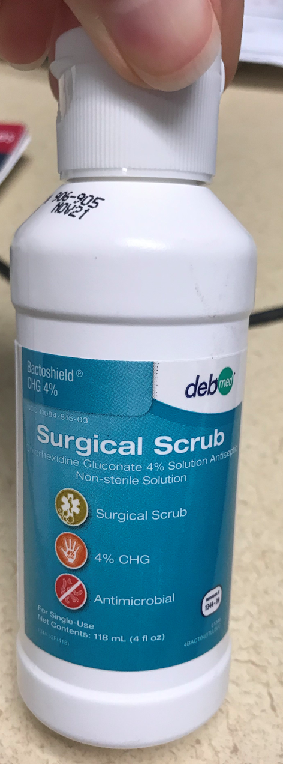
Preoperative Shower with CHG Soap
Begin using (CHG-Chlorhexidine) wash 3 days before the day of your surgery.
DO NOT use on your face, hair, genital
areas, or any open wounds.
Use clean washcloth and towel for each shower.
Apply clean set of sheets first night of showering process and before you return home.
Notes:
You will receive 2 bottles of CHG (abx soap)
This soap will help reduce the number of germs on the skin
The purpose is to help reduce the risk of an infection developing at your hip/knee incision.
A nurse at your preadmission appointment will discuss with you in detail how and when to use the soap

Slide 21
Admission to the Hospital

Slide 22
Day of Surgery
Arrive at the hospital 2-2.5 hrs before surgery time. The time and location will be provided to you by your surgeon's office.
  On site lodging is available if needed, Hampton Inn & Suites located at 43 Columbia Street Orlando, 32806, 407-270-6460. Let hotel know you are a patient for reduced rate.
Take approved medications with a sip of water (beta blockers are very important).
You will be directed to the preoperative area where a nurse will prep you for your surgery.
  Family/friends can receive updates in the surgical waiting area (same area)
Notes:
Your surgeon's office will tell you when and where to arrive the day of your surgery, 2-2.5 hrs before surgery time
Your family/friends will be directed to a waiting area
Anyone living outside the Orlando area, we do have lodging near the hospital—The Hampton Inn and their contact info has been provided above
Non-vaccinated patients will be required to have a COVID test.
The COVID center will reach out to you to set up the appt, which usually occurs w/in3 days prior to sx date

Slide 23
Type of anesthesia
This decision is based on the best choice for you once a conversation with your anesthesiologist and surgeon have occurred. You may have:
General anesthesia: inhaled anesthesia gas along with intravenous sedation medications. You may be sleepy for a few hours after surgery but able to feel and move everything.
OR……
Spinal anesthesia: numbing medicine is injected into your back to numb you from the waist down, along with intravenous sedation medications. You may wake up quickly but not be able to feel or move your legs for a couple of hours after surgery.
You will not be awake or remember your surgery with either one of these choices.
Notes:
Read slide

Slide 24
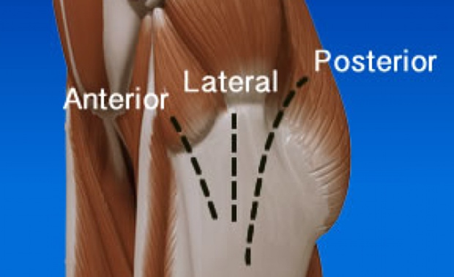
Joint Replacement Videos
Total Knee Replacement—
https://www.nhs.uk/video/pages/Kneereplacementanimation.aspx
Total Hip Replacement—
https://www.nhs.uk/video/Pages/Animationhipoperation.aspx
Your surgeon will determine which approach is best for you!
Notes:
Unfortunately, I am unable to play the videos within this recording. However, you may view them by typing the link into your web browser.
Once you are on the site scroll all the way to the bottom of the page for the video.
There are different approaches with a hip replacement and your surgeon will determine which approach is best for you. Discuss with your surgeon if you are unsure of which approach will be done.

Slide 25
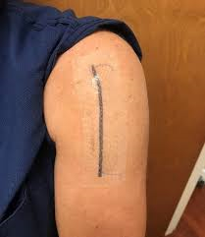
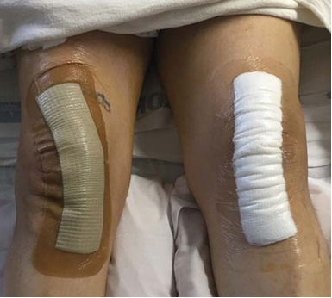
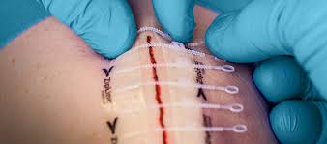
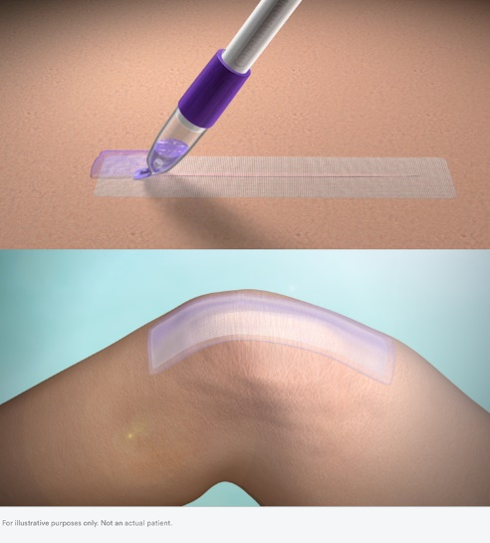
Surgical Dressings
Zipline
Prineo
Aquacell Gauze
Notes:
Here are the most common surgical dressing used to help protect your incision after surgery.
Zipline and Prineo dressings are adhesive dressings left on until your follow up appt with your surgeon. The dressings will be removed in the clinic.
Aquacell dressing is an occlusive/water-proof dressing left on for 5-7 days.
Notify your surgeon of any allergies/skin sensitivities so they can determine the most appropriate choice, which may be a gauze dressing.

Slide 26
What Can I Expect After Surgery?
You will be in the recovery room for about 1-2 hours.
The nurse will monitor your vitals signs and pain level frequently.
You may experience a dry mouth from anesthesia
Your throat may be sore from the airway tube inserted during surgery.
Your hand or arm will have 1-2 intravenous catheters (IVs) so fluid, and medications can be given.
You will be given oxygen to help you wake up.
Your surgeon may order an x-ray of you new joint. This will be done in your bed in the recovery room.
Notes:
You will wake up in the recovery room.
Usually, pts stay in the recovery room for 1-2 hours
If the hospital if very full, the stay may be longer. Everything will be done to keep delays to a minimum.
Initially pain medication may be provided through your IV (intravenous) catheter until you are able to safely drink water and swallow pills.
A sore throat may be experienced after surgery and that is from the airway tube used in surgery. These symptoms will go away in a day or two.

Slide 27
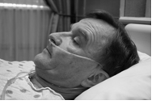
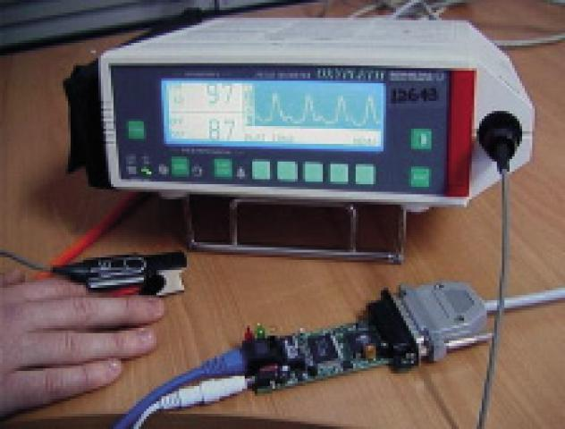
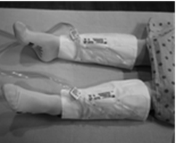
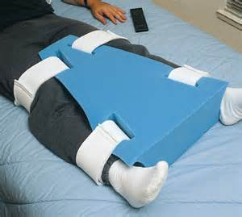
After Surgery You May Have:
A small tube delivering oxygen in your nose.
A clip attached to your finger that monitors your heart rate and oxygen level.
Snug white hose and/or sleeves wrapped around your legs to prevent blood clots.
An abduction pillow (for hips)
Knee Immobilizer
Notes:
A small tube delivering oxygen and probe on your finger will allow the nurse to monitor you and deliver oxygen until you are more awake after your surgery.
Sequential compression devices, which are sleeves wrapped around your legs that fill with air, gently squeezing the legs from ankles to knees to prevent blood clots and swelling.
Sometimes a large foam pillow, called an abduction pillow, will be placed between your legs to help decrease the risk of suffering a dislocation. You must always keep this pillow between your legs, except when standing, sitting, or doing exercises. The abduction pillow is usually used for the first 6-8 weeks after surgery.
A knee immobilizer is a brace that provides additional support when standing and/or walking after a knee replacement. It is typically used within the first 24 hours after surgery.

Slide 28
Admission to Orthopedic Unit
Staff will do what they can to make you as comfortable as possible:
  It is very important to tell the nurse about pain or any other problems so they can address them in a timely manner.
  Your diet will be advanced from liquid (juice, jello, and broth) to solid foods as soon as your nurse feels it is appropriate.
Vitals signs are monitored every 4 hours or more frequently when needed.
Bedside report (nursing handoff) will occur in the morning (6:45-7:15 am) and evening (6:45-7:15 pm). Please let the staff know if you have any questions or concerns during this time. We want to engage you in your care!
Notes:
Upon admission to the orthopedic unit, staff will get you situated in your room.
The nursing staff will continue to monitor your vital signs and pain level throughout your stay every 4 hrs
Staff change shifts in the early morning/evening hours. During these times, nursing will conduct bedside report. The day/evenings events will be discussed allowing you to ask any questions you may have.
We want to engage you in your care!

Slide 29
Admission to the Orthopedic Unit
Unless there is a medical issue, all patients will be assisted out of bed on the day of your surgery.
  Mobilizing patients help reduce your risk of developing blood clots, pneumonia, constipation, and skin breakdown.
We encourage patients to have all meals in the beside recliner. Staying in bed all day is not good for your recovery!
You will be provided an incentive spirometer. This device helps
prevent pneumonia by keeping your lungs clear.
Notes:
All joint replacement patients are mobilized the day of surgery by the nursing staff or physical therapy. The nursing staff does not have to wait for therapy to mobilize patients!
Studies show mobilizing/ambulating pts reduces risk of complications such as blood clots, pneumonia, constipation and skin breakdown.
You will also receive a device called an incentive spirometer to help with lung exercises. Deep breathing uses the muscles of the chest and abdomen to keep the lungs well-inflated and healthy while you heal.
We ask you use the IS at least 10-20x/hour.

Slide 30
Fall Safety
It is important for you to ALWAYS call for help when getting out of bed or walking around.
You may think you can do it by yourself but remember:
  You just had surgery to your hip or knee
  You had anesthesia and pain medication that makes you drowsy
  You may have received a nerve block that has numbed part of your leg
Notes:
Always call for assistance should you need to get out-of-bed.
We provide pts with a yellow fall risk wristband and non-skid socks and use chair and bed alarms to keep you safe from a fall.
The last item pictured to far right is a call bell and the red bottom at the top is used to call for staff assistance.

Slide 31
Physical Therapy
Post-op day 1 (day after surgery)
  Work with PT on bed mobility, transfers, and walking
  Leg exercises to increase strength, range of motion and improve blood flow
  Stair training, if needed
  Family/caregiver training
  Discharge to home if approved by your surgeon and physical therapy
Post-op day 2
  Continue to work on leg exercises to assist with independence
  Increase walking distance
  Discharge to home (*Goal is to be discharge home no later than noon)
Notes:
If you are discharging home the day of surgery, physical therapy will elevate you prior to leaving to make sure you are not having any mobility issues.
Physical therapy evaluates your independence with getting yourself in/out of bed, in/out of bed to chair—vice versa, and walking distance.
How well do you tolerate these activities? Can you do them on your own or do you need assistance?
The average LOS a hip/knee replacement is 1-2 days!
Ultimately the goal is to discharge patient home no later than noon on pod#2 for those that stay overnight in the hospital.
The intent is not to rush anyone out of the hospital. The longer pts are in the hospital it can increase the risk of developing an infection.

Slide 32
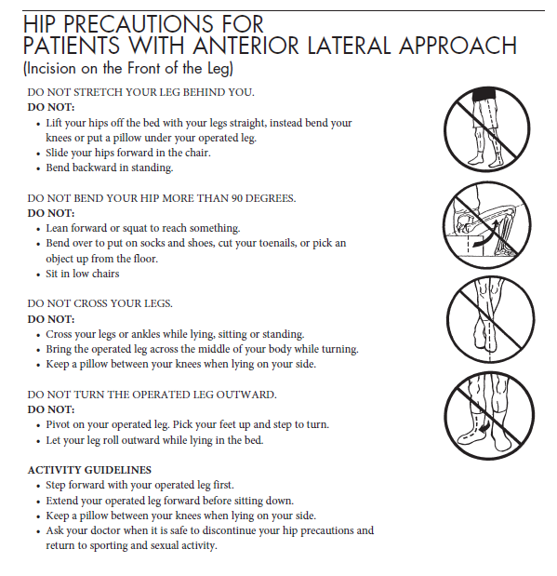
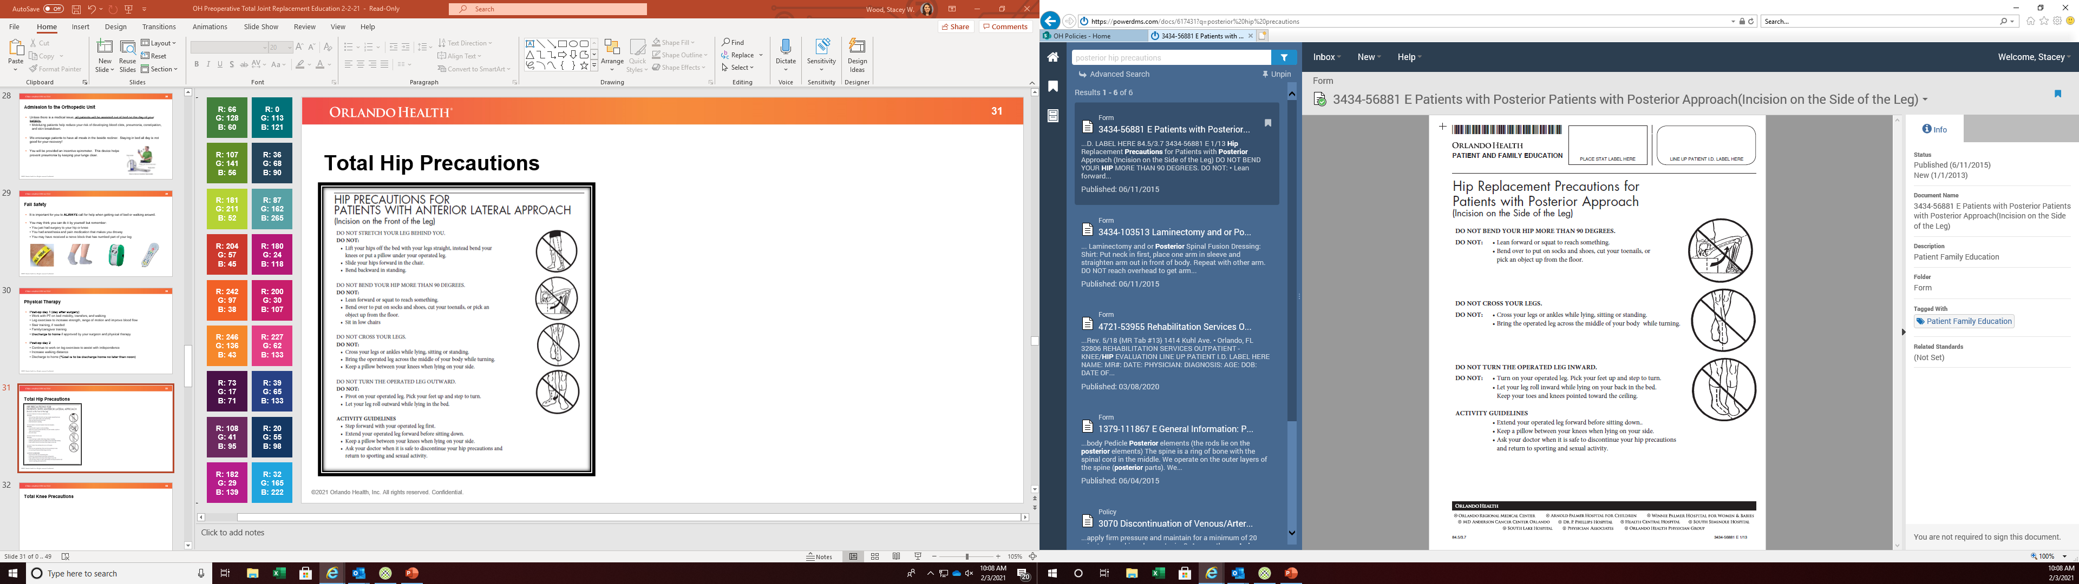
Total Hip Precautions
Notes:
Discuss Lateral and Posterior precautions

Slide 33
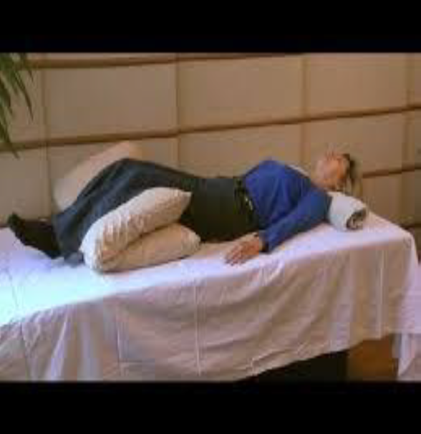

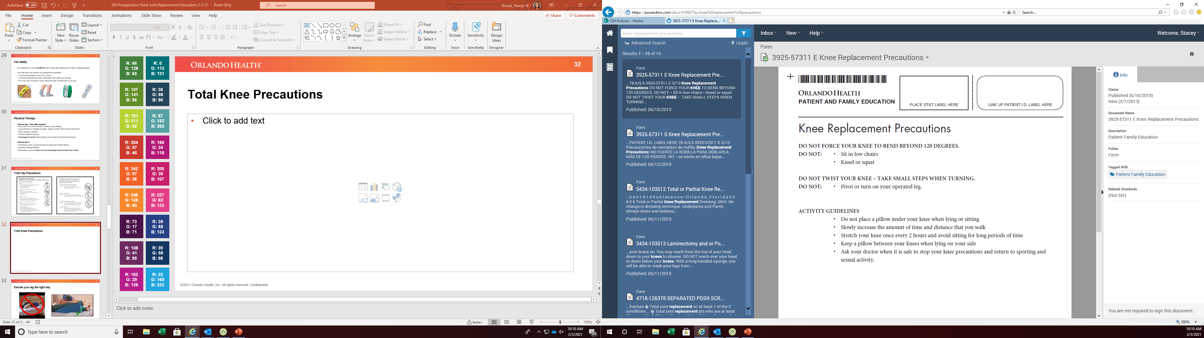
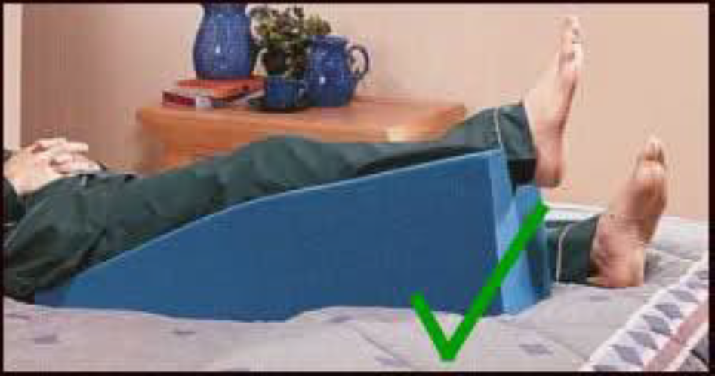
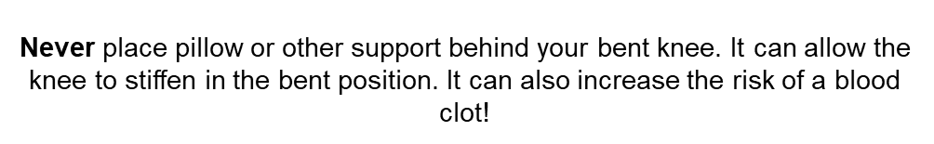
Total Knee Precautions
Notes:
Discuss knee precautions

Slide 34
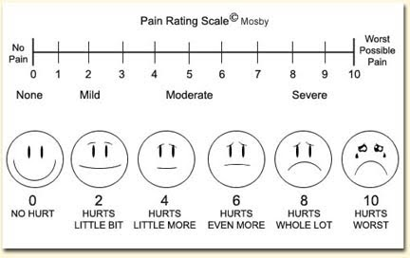
Pain Management
Orlando Health uses 0–10 rating scale to measure pain. No pain is “0.” A “10” means that you have the worst possible pain. Your nurse will ask you for your pain goal. This number represents the pain level at which you will be able to comfortably get out of bed and do physical therapy.
Notes:
Your pain will be assessed throughout your hospital stay.
You will be asked on a scale of 0-10 what is your pain level, along with your pain goal.
The pain goal is a number that represents the pain level at which you will be able to comfortably get out of bed and do physical therapy
A pain goal of zero is not realistic—somewhere between 3-5 is depending on your pain tolerance

Slide 35
Pain Management
Swelling, stiffness, soreness, heaviness of the leg, and some pain is normal after your joint replacement.
We use a variety of methods to help control your pain:
  IV/Oral pain medication—Percocet, Norco, Morphine, or Dilaudid
  Non-steroidal anti-inflammatory (NSAID) medications—Toradol, Ibuprofen, Celebrex
  Muscle relaxers—Robaxin, Flexeril, Baclofen
  Nerve blocks/Exparel/ON-Q Pump
  Cold therapy/ice packs
  Movement/Repositioning
  Physical Therapy
  Relaxation
Notes:
Relaxation—imagery, deep breathing, meditation, etc

Slide 36
Nerve Block
Your surgeon may ask your anesthesiologist to place a nerve block.
This is an injection of numbing medication to the nerve that
goes to your joint.
It is generally done before surgery, after you are sedated.
If given, this can help control pain for the first 24 hours
after surgery.
Notes:
Nerve blocks were designed to help lessen the pain/discomfort experienced after surgery for a short period of time (24 hours).
The anesthesiologist locates the nerve effecting your surgical joint and injects a numbing medication to that nerve.
When it starts to wear off, your leg may feel weak and/or you may start to feel more pain/discomfort.
It is important to take your pain medication as ordered by your surgeon.

Slide 37
Exparel
This is a numbing medicine, injected into the joint during surgery that can help control pain up to 3 days (72 hours).
If given, you may notice an increase in your pain 2-4 days after surgery. This pain increase is normal because the medicine given during surgery is wearing off.
A teal band will need to be worn for the first 4days (96 hours) after surgery, even when you are home. This is a safety measure.
Notes:
Exparel is a numbing medication injected in the tissue around your joint.
It works by slowly releasing the medication into the tissue over time and can last up to 3 days.
The teal-colored wrist band at the bottom of the screen was designed to alert other healthcare providers to not give you medications that contain Exparel for at least 4 days after your surgery.

Slide 38

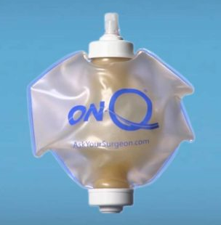
ON-Q Pump
The ON-Q Pump is a device that continuously
infuses a local anesthetic (numbing medication)
for pain management after surgery but does not
effect the muscle tone of the leg.
As the medication is delivered, the pump ball will
gradually soften and then become smaller.
Your surgeon and/or anesthesiologist will
determine if the ON-Q Pump is appropriate for you.

Slide 39
Preparing for Discharge

Slide 40
Pain Management after Discharge
Pain medicine will be prescribed for a short period of time after surgery.
Take medication(s) as prescribed
Wean yourself down as soon as possible to avoid the side effects
  Common side effects are drowsiness, dizziness, low blood pressure, dry mouth, nausea, vomiting, and constipation.
DO NOT drink alcohol when taking pain medicine because it can be dangerous
Please contact your surgeon’s office 2-3 days in advance should you need medication refills
Other ways to lessen pain:
  Ice pack/Cold therapy machine
  Elevate leg to help reduce swelling
  Stay active, move and change positions
  Distraction, relaxation, and deep breathing
Notes:
You will be provided pain medication to discharge home with and the goal is to wean off the medication as soon as possible to avoid the side effects
Discuss side effects

Slide 41
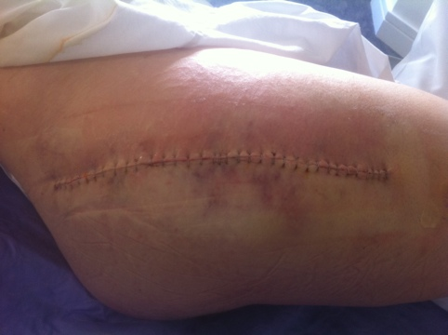
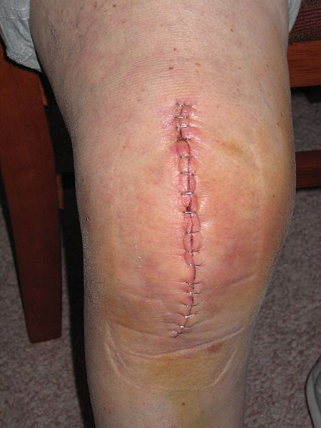
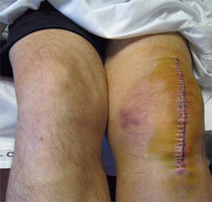
Incisional Care
It is normal for you to have
  Swelling in your leg and/or foot
  Bruising around your knee/hip
  Redness around your surgical incision
  Clear/bloody tinged drainage
  Call your surgeon’s office if you
  have any questions related to your
  surgical site
Notes:
Read slide

Slide 42
Incisional Care
It is not normal for your leg to have:
  Increased warmth and redness around the wound
  Significant increase in pain
  Wound drainage that becomes cloudy, white, yellow,
  or green in color or foul smelling
  Fevers, chills, and night sweats
  Should you develop these symptoms call your
  surgeon right away!
Notes:
Read slide

Slide 43
Incisional Care
Your discharge instructions will tell you how to care for your incision and how often to change the dressing.
DO NOT use the same washcloth or towel for your body and incision.
No baths, pool, Jacuzzis, lake, or ocean swimming until okayed by your surgeon.
DO NOT apply anything to your incision unless instructed by your surgeon. No ointments, creams, lotions, powders to incision. This may increase your risk of infection.
Notes:
Read slide

Slide 44



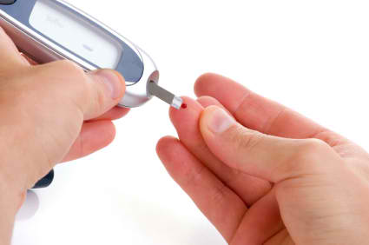
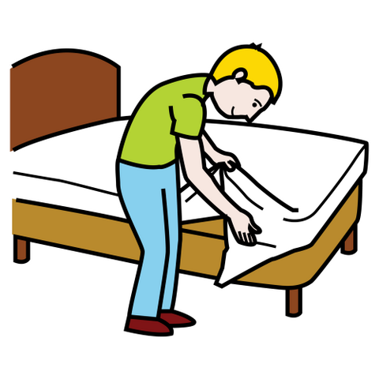
Ways to Prevent an Infection
If you have pets, be careful that they don’t jump on you or get under your feet, causing you to fall. They also carry germs, so wash your hands after petting them, and DO NOT let them sleep with you or lick your incision.
Frequent hand washing
If you are diabetic, keep your blood sugar under tight control
Frequent changes of your bedding and pajamas
Notes:
Read slide

Slide 45
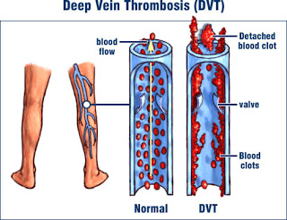
Blood Clot Prevention
Your surgeon will give you a blood thinner to decrease
your risk of developing a blood clot.
  Lovenox
  Aspirin 325 mg
  Eliquis
  Xarelto
Below are some signs & symptoms of a blood clot:
Increased swelling in the affected leg
Significant increase of pain in leg, often starts in the calf and may feel like cramping or soreness
Discoloration of the surgical leg (pale or red and warm to touch)
It is possible for a blood clot to move to your heart, lungs, or brain
Report these symptoms right away to your surgeon!!!
Notes:
Having a joint replacement increases the risk of developing blood clots in the veins of either leg.
The best way to prevent a blood clot is to be active and move as soon as possible after surgery.
Your surgeon will prescribe a medication to help prevent blood clots.
Be sure to take the medication exactly as prescribed.

Slide 46
Activity
Do more activity each day
  Increase walking
  Do your recovery exercises
  Slowly start doing chores
Plan rest periods into your day
  It is normal to tire easily after surgery
Discuss when you can return to work
  Most people return to work in 4-6 weeks. Time off from work depends on your job.
  Talk with your surgeon about work
Ask your surgeon when it is safe to resume intimacy
  Typically resumes within 6-12 weeks but get approval from surgeon first!
Notes:
The more active you are, the quicker you will recover normal function.
Walking will help your recovery, so try to walk every day.
Start with short distance and slowly increase the amount of time and distance that you walk.
You will tire easily so plan for rest periods throughout your day.
Ask your surgeon when it is safe to discontinue joint replacement precautions, return to work, sports and sexual activity.

Slide 47
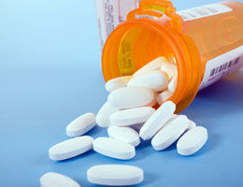
After Surgery Considerations
If you plan on having any type of dental procedure (regular cleaning or surgery) and/or invasive procedure (Colonoscopy, Biopsy, surgical procedures, etc), make sure you tell the physician you have had a joint replacement.
“Prophylactic antibiotics” are usually prescribed to help prevent a possible infection.
No dental work 6-12 weeks after a joint replacement
This is a life-long recommendation!
Notes:
Tell your dentist and physician you have had a joint replacement before undergoing dental and/or invasive procedures.
There is a risk of infection with invasive procedures so the physician may want to prescribe prophylactic antibiotics prior to the procedure—this precaution will apply throughout your lifetime.

Slide 48

Post-operative Appointments
Please be sure you have a follow up appointment scheduled with your:
  Orthopedic Surgeon (as indicated by your surgeon)
  Primary Care Physician (1-2 weeks after surgery)
  Any specialist that gave you surgical clearance (1-2 weeks after surgery)
Notes:
Be sure to keep all your post-op appointments. This lets your doctor make sure you are healing properly, and no infections are developing.

Slide 49
When to Call your Surgeon
Chest pain or difficulty breathing—CALL 911
Call your surgeon for:
  Excessive pain or swelling in your leg
  Pain that is increasing or not controlled by pain medicine
  Numbness or tingling in your lower leg or foot
  A change in color of your leg/foot: pale, dusky, gray or blue
  Chills, fever of 101F or higher, which may be a sign of infection
  Unusual redness, heat, or drainage at the incision site

Slide 50

Stacey Wood, BSN, RN, ONC
Joint Program Clinical Coordinator
Stacey.wood@orlandohealth.com 321-841-7051
Notes:
This concludes the presentation.
I have provided my contact information should you have any questions regarding the material provided.

Slide 51

Please complete the post-test to receive credit for class attendance.
You may complete the post-test (6 questions) by typing the link below into your web browser or scanning the QR code with your phone.
    https://forms.office.com/Pages/ResponsePage.aspx?id=2IGqoZd4C0Gish0ZACS3-Bl7HLVotDdHh1QW2a7BZBhUQ0o2WkRFT1g4OEo3VzJTOTBaU1VCSzI2SS4u
Notes:
In order to receive credit for viewing this presentation you will need to complete the post-test.
The post-test consists of 6 questions and may be accessed by the link above or the QR code.
Your quiz results will be sent to the Joint Program Clinical Coordinator.

