Slide 1

Cervical Spine: Disorders and treatment
2nd Annual Neuroscience Symposium
Saturday, April 13, 2019
Robert Hirschl MD
Chairman of Neurosurgery
Orlando Health

Slide 2
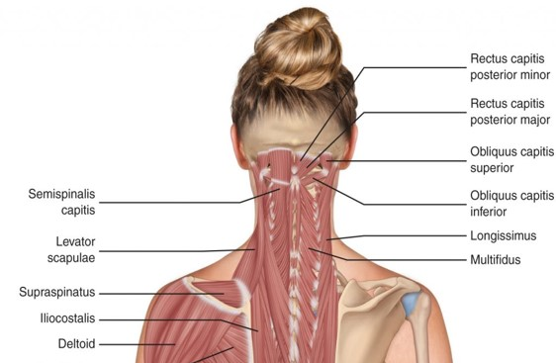
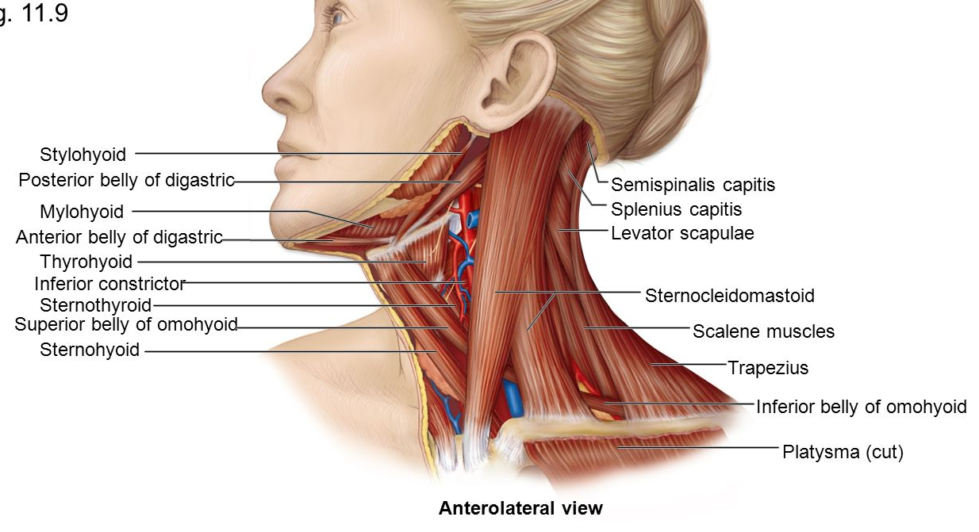
Cervical Spine: Anatomy

Slide 3
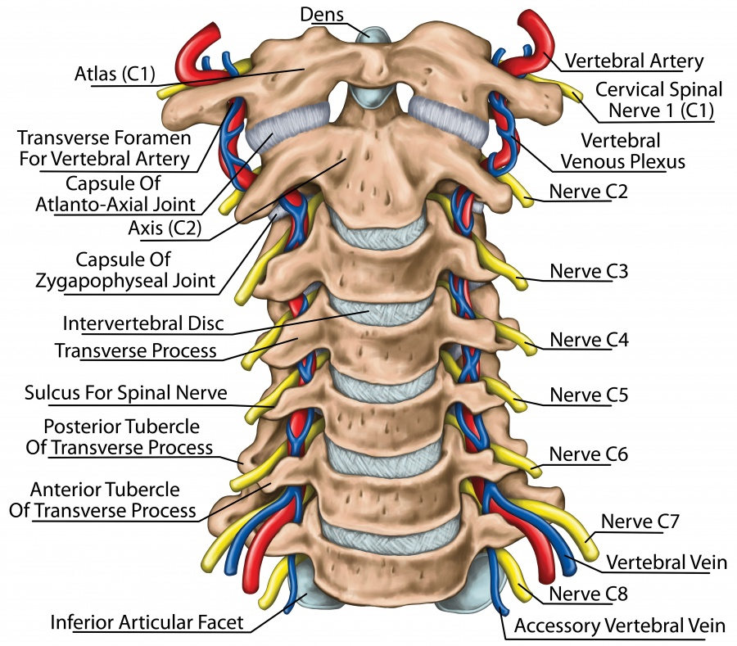
Cervical Spine: Anatomy

Slide 4

Cervical Vertebral anatomy
7 Vertebrae
Upper cervical spine
  C1 – Atlas
  C2 – Axis
50% of rotation occurs at C1/2 junction
Mid Cervical spine
  C3-6
Cervcial Thoracic junction

Slide 5
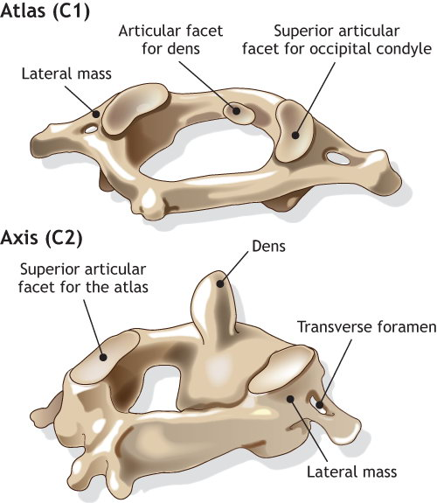
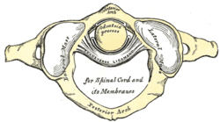

Slide 6
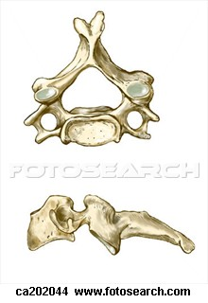
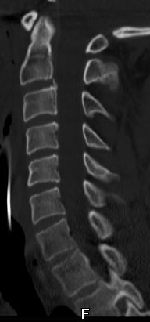
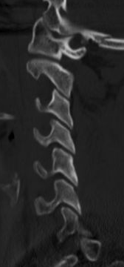

Slide 7
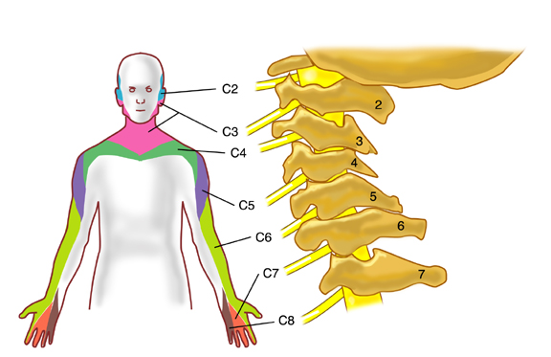
Dermatomes

Slide 8
Motor Function
C3-5 | diaphragm
C5-6 | Deltoid, biceps
C7-8 | Triceps
C8 –T1 | Intrinsic hand mm

Slide 9
Pathologies of the Cervical Spine
1. Degenerative changes
  Herniated Discs
  Disc degeneration / osteophyte formation
  Facet arthropathy
    Central stenosis (myelopathy)
    Foraminal stenosis (Radiculopathy)
2. Trauma
3. Oncology
4. Infections

Slide 10
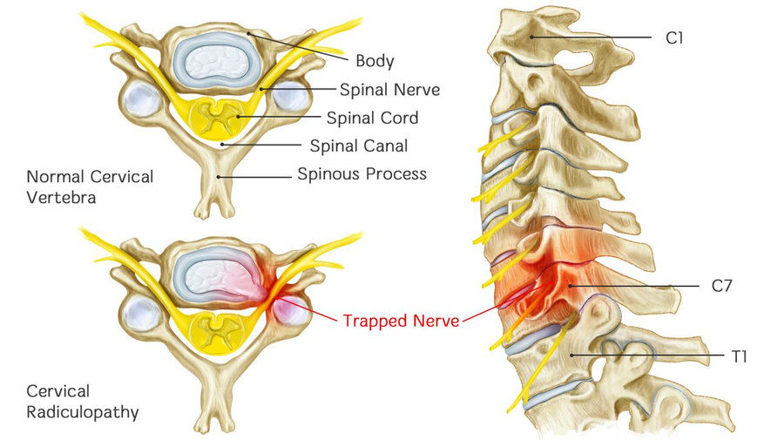

Slide 11
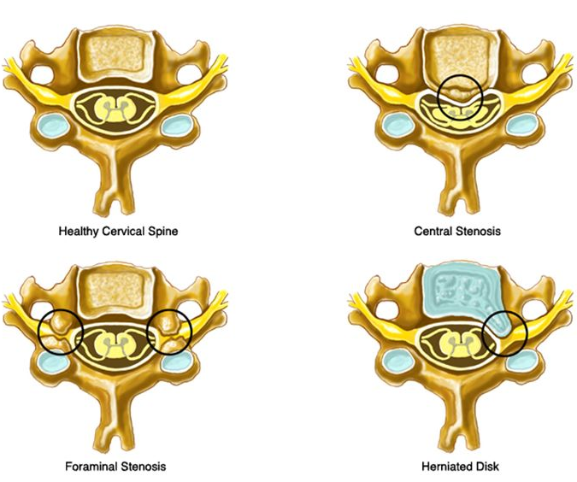

Slide 12
Neck Pain Work Up
History
  Where is the pain?
  Does the pain radiate?
  Sharp, dull ache, “electric shock”?
  When did it start? Inciting event?
  Anything make it better? Worse?
  Any history of Cancer?
  Possible infection (fever, chills, know infection, etc)?

Slide 13
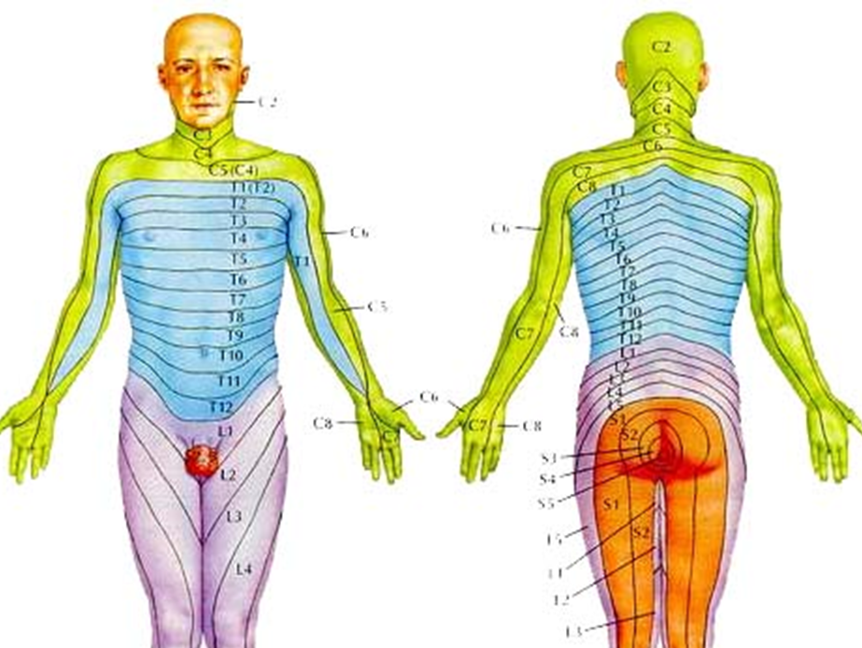
Neck Pain Work Up
Physical
C3-5 | diaphragm
C5-6 | Deltoid, biceps
C7-8 | Triceps
C8 –T1 | Intrinsic hand mm

Slide 14
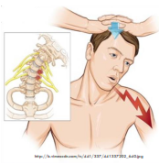
Physical exam (cont)
Spurling’s sign
  Tilt patient head to effected side and press down.
  Positive test causes pain down the arm.

Slide 15
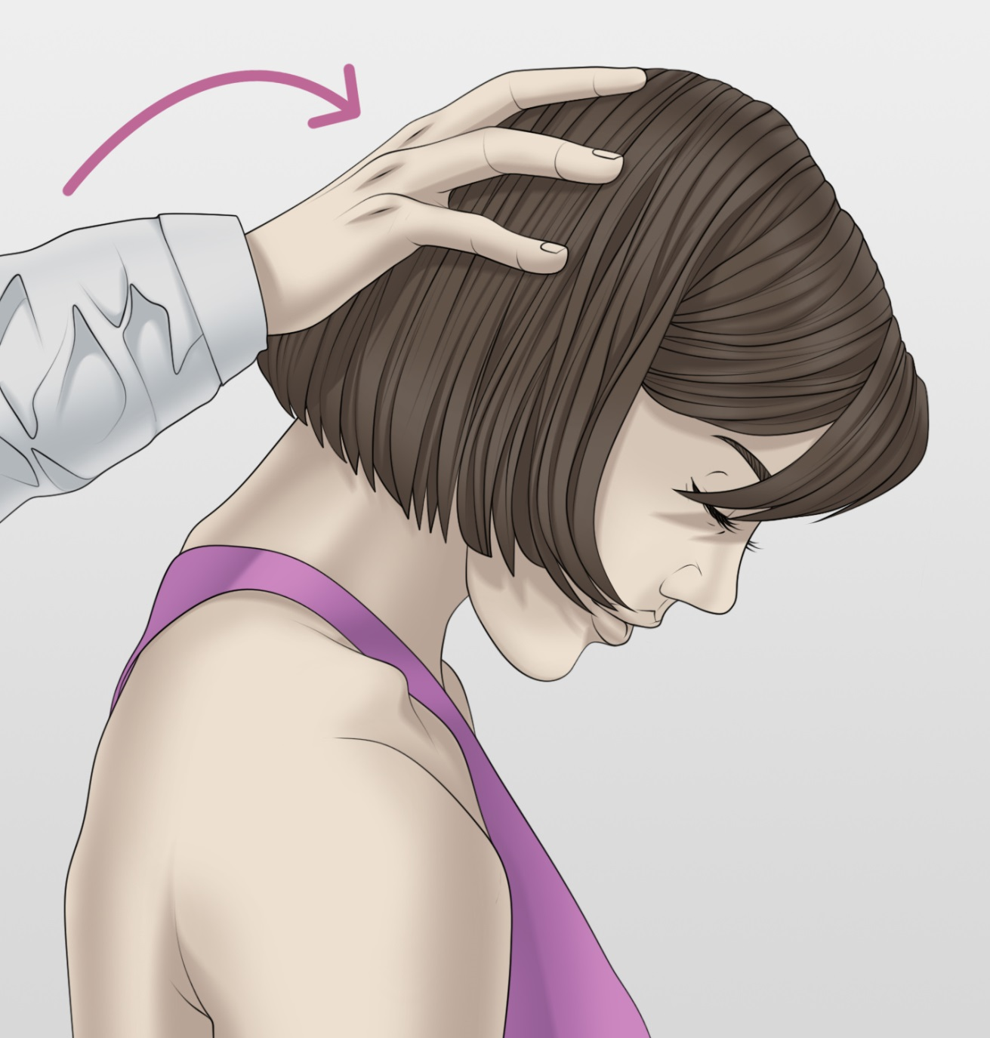
Physical exam (cont)
Lhermitte's sign
  Flex patients head forward
  Electrical shock sensation down spine into arms and legs
  Not specific
    MS
    Transverse myelitis
    Central stenosis
    Etc.

Slide 16
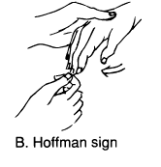
Physical exam (cont)
Hoffman’s sign
  Extend 3rd digit and “snap” nail bed
  Thumb flexion is positive sign
  Upper motor neuron finding

Slide 17

Treatment: Patient categories
Pure axial Neck pain
  No Red flags
  Neurologically intact
Axial neck pain with radiculopathy
Axial neck pain with meylopathy
Any above with red flags

Slide 18
Red Flags…
Condition | Red Flags Associated With Condition
Infection | Symptoms of infection (fever, chills) Risk factors for spinal infection (eg. diabetic patients, patients with chronic catheterization, IV drug abuse, immunosuppression, penetrating wound)
Fracture | Major trauma Minor trauma involving patient with known osteoporosis, and/or chronic steroid use, or known spinal tumor
Malignancy | History of malignancy >50yrs old Unexplained weight loss Pain at night Pain at rest

Slide 19
Pure Axial Neck Pain (NO Red Flags)
Primary care physician (Gate Keeper)
  Surgeon (Neuro or Ortho) should not be first line!
Treatment Plan (Conservative Tx)
  Analgesics: Over the counter anti-inflammatory (NSAIDs)
  Limit activity (but NOT bed rest)
  Time…......most will resolve in 6 weeks
  May consider PT or Pain physician referral (depending on severity of pain)
  Quit smoking
  Weight Loss
  (Imaging not needed).

Slide 20

Alternative Therapies
Physical Therapy
Acupuncture
Chiropractic Medicine
Bracing
Osteopathic Manipulation
Low Impact Exercise
Massage
Steroid Injections

Slide 21
Pure Axial Neck Pain (NO Red Flags) cont.
If no improvement in 6 weeks
Referral to PT, or pain physician is appropriate if not already done
Imaging of the affected area maybe warranted (MRI study of choice)
If imaging is abnormal and pain persists greater than 6 weeks, then consultation with spine specialist is appropriate.

Slide 22
Neck Pain with radiculopathy
If just PAIN and neurologically intact
  same algorithm as pure axial back pain
  Except would recommend addition of Neurontin
If Parasthesias / sensory changes
  Would Recommend MRI of Cervical spine if able
  Referral to Spine specialist

Slide 23
Neck Pain with radiculopathy
If Weakness is present
  Recommend Imaging (MRI)
  Urgency depends on duration of symptoms
    < than 24 hrs = emergency
    24-48 hrs = urgency
    > 72 hrs = as soon as possible
    (unless symptoms are getting worse = possible emergency)

Slide 24
Neck Pain Red Flags
If neurologically intact – recommend expedited imaging
  MRI is test of choice
    Cancer or infection = with and without gad
If neurologic deficits present
  Needs imaging / workup emergently
  Recommendation is to either send to ER or have patient admitted to hospital where spine experts have privileges.

Slide 25
Neck Pain from PCP standpoint
When to worry?
Red Flags
  History of Cancer
  Fever / chills, WBC, signs of infection
Neurological defecits (motor / sensation)
These patients require urgent / emergent medical attention

