Slide 1
Orlando Health Concussion Recovery Program
Neuroscience Symposium
April 13, 2019
Marissa Conrad, MS, PT, NCS, CBIS
Kristie Figueroa, MS, SLP-CCC, CBIS
Alina Perez, MS, OTR/L, CBIS

Slide 2
Objectives
Concussion Overview
Interdisciplinary Team Approach
Early Intervention – Concussion Recovery Program

Slide 3
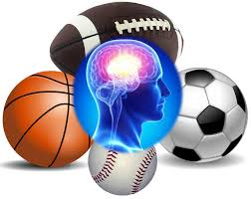
Concussion
The Centers for Disease Control (CDC) estimates that 1.6 to 3.8 million people experience concussions during sports and recreational activities annually in the United States.
Notes:
These numbers may be underestimated, as many cases are likely never reported

Slide 4
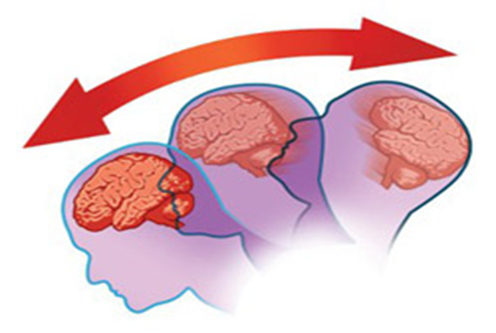
Concussion Overview
A concussion is considered a mild traumatic brain injury.
A concussion may be present even though all imaging is negative.
Notes:
During neuronal injury, the injured neuron releases K+, which rushes out of the cell body, and toxic Ca2+ ions rush in, causing damage and leading to metabolic dysfunction.
This leads to a hyper excitable state and is why rest is indicated immediately following concussion. We want to avoid overstimulation initially and ramp up exercise and activities as appropriate and able.

Slide 5
Recovery Expectations
The majority of symptoms resolve within 2-3 weeks
Small subset of patients experience symptoms after 3 months
Notes:
Children may take a little bit longer .
“Patients with these risk factors may need to be identified for early concussion assessment following suspected head injury and provided with more conservative care and frequent follow-ups after their injury.”
“earlier treatment of secondary risk factors may lead to a more rapid recovery”

Slide 6
Outpatient Concussion Therapy Team
SLP/OT
PT
PT/OT
MD
PT
Neuropsychology/MD
Notes:
University Pitt Medical Center
6 Domains/concussion clinical trajectories typically affected by concussion
Comprehensive, multidisciplinary approach is required to address these domains and treat the whole individual
Identification of concussion clinical trajectories and targeted treatment pathways help to ensure efficient and effective treatment

Slide 7
Common Symptoms Observed
Attention/Memory
Dizziness
Motion Sensitivity
VOR Impairments
Visual processing
Visual perception
Convergence Insufficiency
Oculomotor Impairments
Headache
Dizziness
Pain
Fatigue
Emotional Overlay
Notes:
Cognitive – often attention/memory are reported, however…
Vestibular: vestibulo-ocular reflex
Ocular: convergence insufficiency is very common
Migraine:
“unilateral, moderate to severe intensity headache following a head trauma with a pulsating quality that is associated with nausea and photosensitivity and/or phonosensitivity and is often aggravated by physical activity.”
Often exacerbated by stress, sleep dysregulation, anxiety or emotional changes in addition to dietary triggers including caffeine.
Most common treatment is pharmacological intervention
If ongoing symptoms are exacerbated by minimal activity and no longer respond to rest, this may represent psychological symptoms related to prolonged inactivity and frustration with inability to return to usual activities. Neuropsychology can help.
These patients will demonstrate Hypervigilance, will report of feeling overwhelmed, sadness, hopelessness and disturbed sleep
Providing these patients with a daily exercise plan and having them track their progress will help to refocus their attention and will likely help to speed recovery

Slide 8
Intervention – New Guidelines
Previous recommendations included:
No activity with complete rest until asymptomatic
New research demonstrates:
Graded exercise assessments are safe and aerobic exercise improves symptoms (Sullivan, 2018)
Early physical activity in the acute phase following a concussion may decrease the time needed for symptom resolution compared to immediate rest (Lempke, 2019)
Moderate levels of cognitive and physical exertion over the first month post-injury had improved outcomes over small or large amounts (Sawyer, 2016)
Notes:
Concussion research is ever changing and evolving.
Initially, it was recommended to avoid activity and rest completely following concussion.
Now research is showing that early physical activity and exercise are beneficial following concussion. Graded exercise assessments and moderate physical activity in the acute phase are safe and recommended following concussion.
Moderate levels of cognitive and physical exertion following concussion are more beneficial than small or large amounts (need to find the sweet spot to facilitate recovery).

Slide 9
Intervention Guidelines
“Even brief periods of restricted physical inactivity or bed rest have negative effects on cardiovascular musculoskeletal, metabolic, endocrine, hematologic and psychological functioning and can results in symptoms (light headedness, fatigue, dizziness, irritability etc) that are similar to those observed among patients with acute concussion” (Ellis 2018)
Patients with poor coping skills may demonstrate maladaptive behaviors that affect overall recovery.
Education and reassurance are the most effective forms of early intervention and may help prevent anxiety, poor coping skills and limited recovery.
Sandel, Reynolds, Cohen, Gillie, Kontos. Anxiety and Mood Clinical Profile Following Sports-Related Concussion : From Risk Factors to Treatment. Sports Exercise and Performance Psychology 2017 (Vol 6, No. 3, 304-323)
DiFazio, M., Silverberg, N. D., Kirkwood, M. W., Bernier, R., & Iverson, G. L. (2016). Prolonged Activity Restriction After Concussion: Are We Worsening Outcomes? Clinical Pediatrics, 55(5), 443-451.
Notes:
This research is discovering that even brief periods of restricted physical inactivity or bed rest have negative effects on patients and can result in symptoms of light headedness, fatigue, dizziness and irritability, which are similar to concussion symptoms! It is important to get these patients moving and encourage a gradual return to activity to avoid these detrimental effects.
Patients with poor coping skills and a history of anxiety may demonstrate maladaptive behaviors that affect overall recovery and result in protracted recovery.
Education and reassurance are the most effective forms of early intervention and may help prevent anxiety, poor coping skills and limited recovery. This is essential information and really goes a long way with concussion patients.

Slide 10
2018 CDC Guidelines for Children
“Related evidence suggests that early rest (within the first 3 days of injury) may be beneficial, but that inactivity beyond this period for most children may worsen their self reported symptoms.”
“Following these first several days, health care professionals should counsel patients and families to resume a gradual schedule of activity that does not exacerbate symptoms, with close monitoring of symptom expression.”
“Because post-concussive symptoms resolve at different rates in different children after mTBI, individualization of return-to-school programming is necessary.”
Lumba-Brown, A, et al. Centers for Disease Control and Prevention Guideline on the Diagnosis and Management of Mild Traumatic Brain Injury Among Children. JAMA Pediatrics 2018 (Vol 172, No. 11, 1-13)
Notes:
CDC recently updated their recommendations for children.
They recommend a brief period of rest but state that inactivity beyond 3 days following injury may lead to a worsening of self reported symptoms.
It is truly important to encourage and emphasize a return to activity. It should be a gradual return to activity, with symptom monitoring to avoid exacerbation of symptoms.
Every child and recovery is different. It is important to customize return to school accommodations to ensure a successful return to school.

Slide 11
Early Intervention
Education / Reassurance:
Explanation of injury
Expected signs/symptoms
Expectation for recovery
Strategy education to reduce symptoms
Behavioral regulation plan
Sleep schedule
Adequate nutrition/hydration
Daily movement
Stress management
Utilize positive framework to minimize nocebo effect
Sandel, Reynolds, Cohen, Gillie, Kontos. Anxiety and Mood Clinical Profile Following Sports-Related Concussion : From Risk Factors to Treatment. Sports Exercise and Performance Psychology 2017 (Vol 6, No. 3, 304-323)

Slide 12
Early Intervention – Return to Learn / Work
Avoid comprehensive cognitive assessments early on to prevent nocebo effect
Return to Learn: starts 2-5 days post injury; includes stepwise protocol to ensure gradual return to learning activities to avoid exacerbation of symptoms
Return to Work: assistance with returning to work duties and providing recommendations as needed
Willer, Barry, Leddy, John. Management of Concussion and Post-Concussion Syndrome. Current Treatment Options in Neurology. 2006 (8;415-426)

Slide 13
Outpatient Evaluation – Physical Therapy
Cerebellar
Dysdiadochokinesia, finger to nose
Oculomotor
VOMS
Smooth Pursuits, Saccades, Convergence
Vestibular
74% of concussion patients with post traumatic dizziness were found to have positive vestibular abnormalities findings
Dynamic Visual Acuity assessment
BPPV screen
Musculoskeletal
Cervical spine assessment
Balance Tests
Sensory Organization Test
Gait Assessment
Exertion Testing with HR monitoring
Self Assessment
Notes:
When I do my PT evaluation I am always thinking of those concussion domains/trajectories that Alina mentioned earlier.
I want to assess the patient’s general strength and coordination.
Oculomotor and vestibular assessments are extremely important. Abnormalities in the oculomotor and vestibular system are frequently seen following concussion. I use the VOMS (vestibulo-oculomotor screen for concussion) to help identify deficits in the oculomotor or vestibular domains. This screening tool assesses smooth pursuits, saccades, convergence, VOR function and motion sensitivity. All of these things are amenable to treatment.
I am a vestibular therapist and therefore dive a little deeper in the vestibular assessment – 74% of concussion patients with post traumatic dizziness were found to have positive vestibular abnormalities.
This type of patient will often report of dizziness with head and body movements, when bending over, turning while walking, etc. If I hear these complaints, I suspect VOR deficit. It is important to complete a dynamic visual acuity assessment on these individuals to assess their vision while their head is moving. If there is impairment here, it could lead to symptoms of motion sensitivity, fogginess, dizziness and nausea. I do use infrared goggles for gaze assessment and I additionally complete a BPPV screen to assess for positional vertigo.
Since the head is attached to the neck, we want to assess the cervical spine. I generally complete a range of motion assessment in addition to deep cervical flexion rotation test which will help identify any upper cervical spine limitations.
Balance testing is completed and we generally use the Sensory Organization Test to assess dynamic balance. This test looks at the sensory components of balance including vision, vestibular system and proprioception.
Exertion testing is completed with heart rate monitoring to identify the symptom threshold based on HR. This will assess for exercise intolerance. The degree of exercise intolerance may be predictive of delayed recovery.
Self assessment is completed and we generally use the SCAT 5 symptom report or the Rivermead. Both are valuable tools to help identify initial symptoms and monitor progress and the patient’s perspective.

Slide 14
Treatment – Physical Therapy
Oculomotor treatment
Vestibular therapy
Typically rapid head or body movements exacerbate symptoms, difficulty seeing while head is moving, dizziness, fogginess, nausea and a feeling of being detached, anxiety and overstimulation in more complex environments
Exertion Training
Cervical Spine treatment
Return to Play Protocol: initiated for athletes
Medical clearance is necessary for ALL athletes prior to return to play to reduce risk of Second Impact Syndrome
Gurley JM, Hujsak BD, Kelly JL. Vestibular rehabilitation following mild traumatic brain injury. NeuroRehabilitation 2013;32(3):519-28.
Notes:
With physical therapy treatment, we basically treat all deficits identified in the initial evaluation. And I will tell you that rehab works! Not only is it supported in the literature, but I have personally seen amazing outcomes with concussion patients following therapy. We want to make sure these individuals can see clearly when their head is moving, that their dizziness stops and their balance improves, we want to make sure they are conditioned and strong and their cervical spine mobility is functioning as it should to ensure they are able to return to work, school and recreational activities safely.
Oculomotor deficits are common and are amenable to treatment. Convergence insufficiency is frequently seen and can get better with treatment. 60% of individuals post concussion experience smooth pursuits and convergence abnormalities.
Vestibular treatment needs to be progressed gradually and appropriately. These exercises can be tricky and can bring on symptoms of dizziness, which is expected. It is important to explain the process to patients so they are set up for success and have a good understanding of why you are making them dizzy and doing what you are doing. A simple example of a vestibular progression would be to complete Vestibulo-Ocular exercises in sitting and then progress to standing and then while walking, etc.
With exertion training, we hope to facilitate improved tolerance to exercise and safe return to prior levels of activity including sports. Leddy et al (2010) and Baker et al (2012)
Studied concussed athletes and non-athletes in chronic phase
Identified symptom threshold (ST) for HR
And recommended to start exercising at 80% of ST and gradually increase as long as symptoms under control
Aerobic exercise was completed 5-6 days per week for as long as patient can tolerate without increase in symptoms
With this 72% returned to full daily functioning. This is pretty good considering these are people who have been dealing with these concussion symptoms chronically. This type of training is not just beneficial to the athlete and can be completed on any active individual.
Cervical spine should not be ignored and can very well be contributing to dizziness and headache symptoms. Manual therapy including muscle energy techniques, soft tissue mobilization and stretching can be very beneficial to those experiencing a cervical spine trajectory following concussion.

Slide 15
Treatment – Cognition at 12 weeks
Most cognitive symptoms will resolve early on but 5-15% of patients continue to experience cognitive symptoms after 90 days.
If symptoms persist at week 12, then patient demonstrates residual cognitive deficits and traditional cognitive therapy is recommended.
Sohlberg, M. M., & Ledbetter, A. K. (2016). Management of Persistent Cognitive Symptoms After Sport Related Concussion. American Journal of Speech Language Pathology, 25, 138-149.

Slide 16
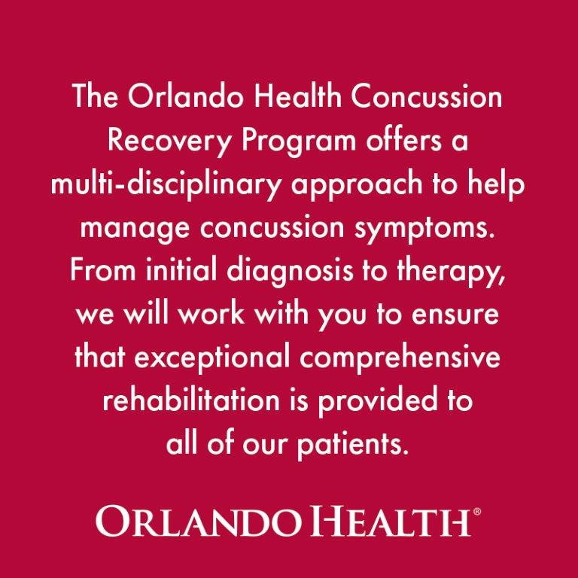
Contact us:
Orlando Health Outpatient Rehab
100 W. Gore Street
Suite 104
Orlando, FL 32806
Phone: (407) 841-8911
Fax: (407) 843-6762
Marissa.Conrad@orlandohealth.com
Kristie.Figueroa@orlandohealth.com
Alina.Perez@orlandohealth.com

Slide 17
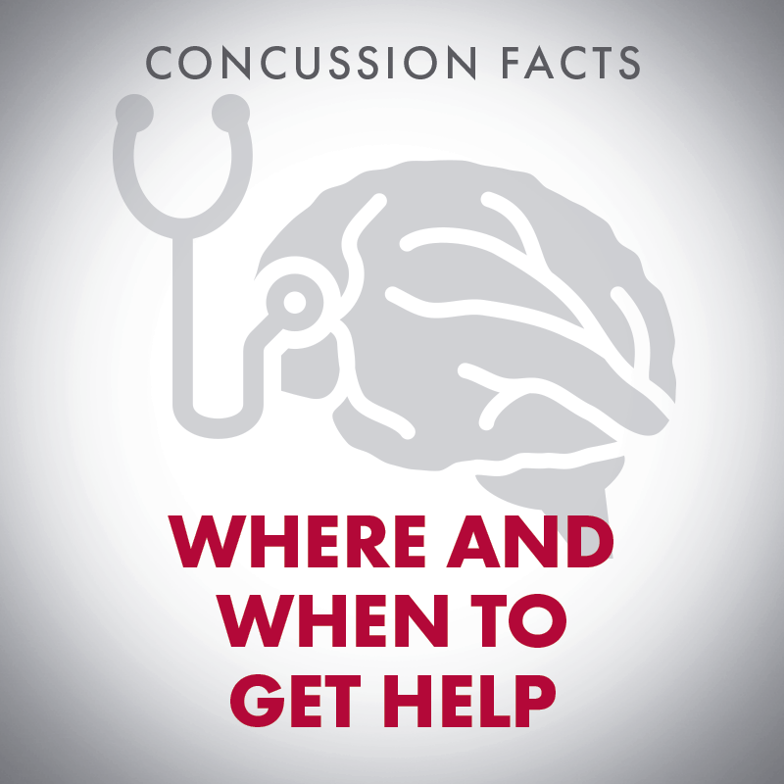
Thank YOU!

