Slide 1
Conservative Low Back Pain Treatment- a Physical Therapist perspective
Colleen Scordato, DPT, Cert. MDT
April 13, 2019

Slide 2
Objectives
How PT can transform pain management
Efficacy of modalities
Impact of pain neuroscience education
Importance of finding a directional preference
First exercise for healing

Slide 3
PT & pain management
CDC recommends “high quality evidence”
Treatments provided by physical therapy are effective
Reducing pain, improving function in LBP
Exercise
Correlation regular exercise and decrease in pain
Review of 60 randomized control trials exercise therapy for adults with LBP
Decrease pain, improve function & help return to work
Manual therapy
Hands-on manipulation of joints and soft tissue
Modulate pain, reduce swelling & inflammation, improve mobility
Effective in treating low back pain

Slide 4
PT & pain management
Stress management
Mindfulness, relaxation, visualization & graded exposure to stress-producing events
Reduce pain & improve function
Sleep hygiene
Deprivation can increase sensitivity levels, increase stress & pain
Pain neuroscience education
Educate on modern pain science; empower patients to overcome persistent pain
Pain-centric to Function-centric

Slide 5
Efficacy of modalities for LBP
High freq. > low freq. TENS improves short term pain, improves emotional role limitations and decreases acetaminophen use
No impact on perceived disability or long term pain
Moderate evidence dry needling of myofascial trigger points if associated with other therapies, recommended to decrease intensity of LBP post-intervention
Improving functional disability remains unclear
Not approved for FL PTs currently

Slide 6
Efficacy of modalities for LBP
Therapeutic ultrasound is not recommended for short term pain relief of neck or low back pain
Not supported by research
Lumbar traction has little to no impact on clinical outcomes

Slide 7
Impact of pain neuroscience education
Only been around for < 2 decades
Renaissance period, religious and spiritual belief influence
1965 Melzack- gate control theory
Early 1990s- functional brain scans
First documented use of PNE as treatment in 1999, Louis Gifford presented at the International Association on the Study of Pain

Slide 8
Impact of pain neuroscience education
PNE
Aims to explain to patients the biological & physiological processes involved in a pain experience
Defocus the anatomical structures
No longer “biomedical” model
Tissue healing time frames
“Know pain, know gain.”
Changes occur in the brain

Slide 9
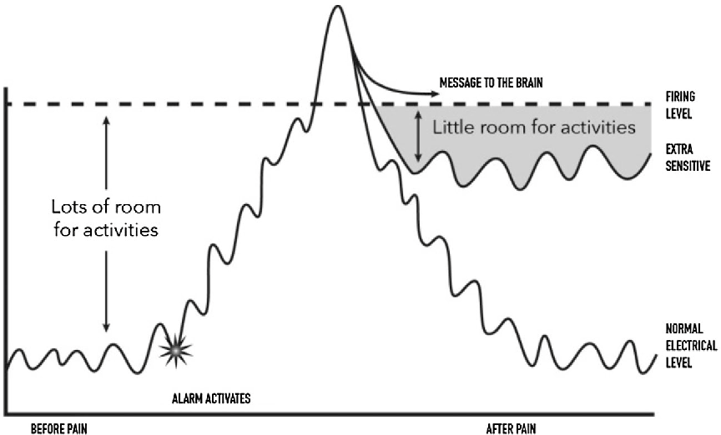
Impact of pain neuroscience education
The body’s Alarm system

Slide 10
Impact of pain neuroscience education
What can keep pain elevated?
Failed treatment, family concerns, fear and anxiety, ongoing pain, job issues, different explanations
Brain’s pain meeting
The pain cycle
Response to pain/stress
Chemicals effect
Appetite, mood swings, sleep, concentration, memory and depression
Fear avoidance & psychosocial factors contribute to pain
Notes:
Different explanation = not understanding your why? Diagnosis or reason for pain
Area’s of the brain the have normal tasks are now functioning and hijacked for pain
Sensation, tissues, problem solving, thoughts, memory, focus, stress, fear, muscles

Slide 11
Impact of pain neuroscience education
“Despite the pain”, I can do x, y, z
Laterality differentiation 1st change to occur
Proprioception exercises
Notes:
Focus on function

Slide 12
Impact of pain neuroscience education
1 & 3-yr follow-up of a randomized control trial comparing preoperative neuroscience education for patients undergoing surgery for lumbar radiculopathy
↓ cost X-rays, visits to family physician, PT & massage therapists
1-yr Medical expenses 45% lower for experimental group
Annual savings of 1.2 billion if applied to every patient undergoing discectomies in the U.S.
3-yr Medical expenses 37% lower for experimental group

Slide 13
Treatment- Significance of DP
Different theories of treating low back pain
McKenzie, Maitland
Directional preference
reliable and predictable clinical solutions for decreasing pain and improving functional outcomes
Flexion vs. Extension
Loaded or unloaded
With or without overpressure
Sidegliding right vs. left
Rotation right vs. left

Slide 14
Treatment- Significance of DP
Educate patient
Avoiding direction that produces symptoms until full range in the opposite direction is obtained
Flexion
Slouched sitting
Forward bending
Extension
Standing
Walking

Slide 15
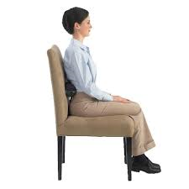
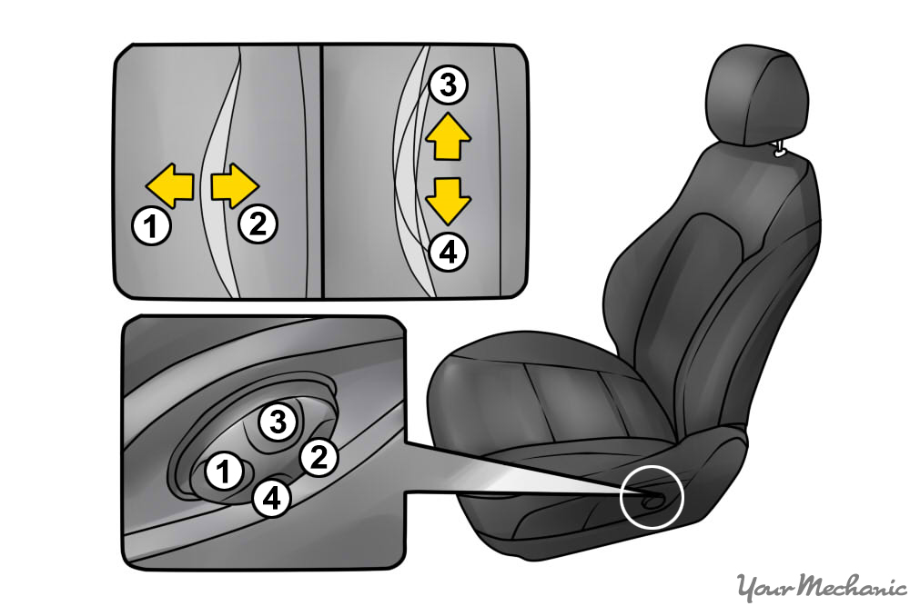
First to consider- Posture
Sitting
Lumbar roll
Feet on floor
Use arm rest
Driving
Lumbar support
Recline to 100°
Tilt seat pan downward

Slide 16
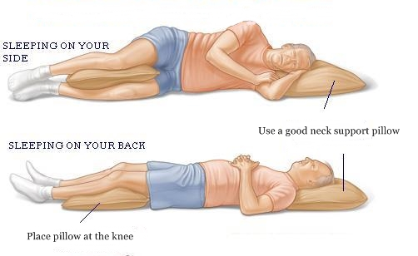
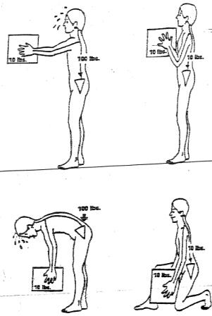
First to consider- Posture
Sleeping
Side lying to supine
Lifting
½ kneel
Squat
SL deadlift

Slide 17
Conclusion
Efficacy in PT for conservative low back pain patients
Pain neuroscience education
Directional preference
Empower patients to follow through with home exercise based on his/her symptom response
Modalities are not supported with research
First home treatment should be posture

Slide 18
References
Airwaily M, Almutiri M, Schneider M. Assessment of Variability in Traction Interventions for Patients with Low Back Pain: A Systematic Review Chiropractic & Manual Therapies 2018 26: 1.
American Physical Therapy Association (2018). Beyond Opioids: How Physical Therapy Can Transform Pain Management to Improve Health [white paper] Retrieved January 9, 2019, from APTA.org.
Butler DS, Moseley GL 2003 Explain Pain. Adelaide, Noigroup Publications.
Liu L, Huang QM, Liu QG, Thitham N, Li LH, Ma YT, Zhao JM Evidence for Dry Needling in the Management of Myofascial Trigger Points Associated With Low Back Pain: a Systematic Review and Meta-Analysis. Archives of Physical Medicine and Rehabilitation 2018 99: 144-152.
Louw A, Puentedura EJ, Zimney K, Schmidt S Know Pain, Know Gain? A Perspective on Pain Neuroscience Education in Physical Therapy. Orhopedic Sports Physical Therapy 2016 46: 131-134.
Louw A, Diener I, Landers MR, Puentedura EJ Preoperative pain neuroscience education for lumbar radiculopathy: A multicenter randomized controlled trial with 1-year follow-up. Spine 2014 39: 1449-1457.

Slide 19
References
Louw A, Diener I, Landers MR, Zimney K, Puentedura EJ Three-year follow-up of a randomized controlled trial comparing preoperative neuroscience education for patients undergoing surgery for lumbar radiculopathy. Spine 2016 2: 289-298.
Louw A, Zimney K, Puentedura EJ, Diener I The efficacy of pain neuroscience education on musculoskeletal pain: A systematic review of the literature. Physiotherapy Theory & Practice 2016 32: 332-355.
Noori SA, Rasheed A, Aiter R, Jung B, Bansal N, Chang KV, Ottestad E, Gulati A Therapeutic Ultrasound for Pain Management in Chronic Low Back Pain and Chronic Neck Pain: A Systemic Review. Pain Medicine 2019: 287.
Poitras S, Brosseau L Evidence-informed management of chronic low back pain with transcutaneious electrical nerve stimulation, interferential current, electrical muscle stimulation, ultrasound, and thermotherapy Spine 2008 8: 226-233.
Yaiznbowicz R. Tao M Directional preference constructs for Patients’ Low Back Pain in the Absence of Centralization Journal of Manual and Manipulative Therapy 2018 26: 281-291.
Yaiznbowicz R, Tao M, Owens A, Wlodarski M, Dolutan J Pain Pattern Classification and Directional Preference are Associated with Clinical Outcomes for Patients with Low Back Pain Journal of Manual and Manipulative Therapy 2018 26: 18-24.

Slide 20
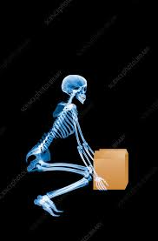
Questions?

