Slide 1

THORACIC SPINE
Principles and pathology
Virgilio Matheus, MD, FACS
Orlando Health Neurosurgery

Slide 2
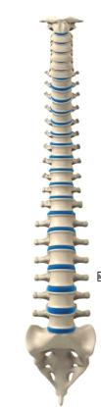
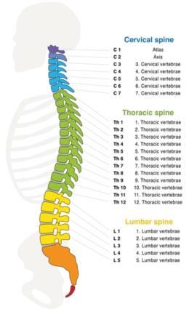

Anatomy
Coronal Sagittal

Slide 3
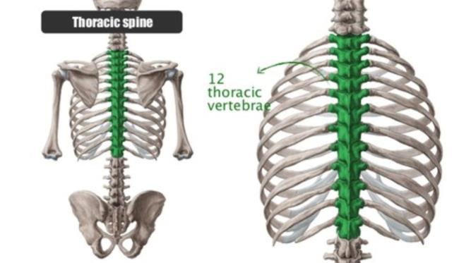
Anatomy

Slide 4
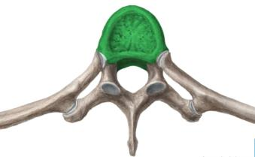
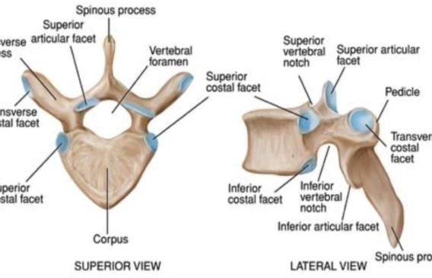
Anatomy

Slide 5
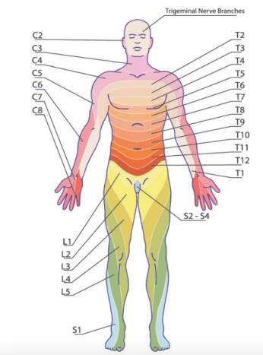
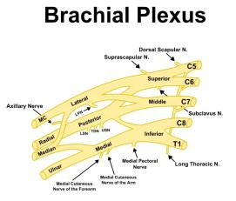
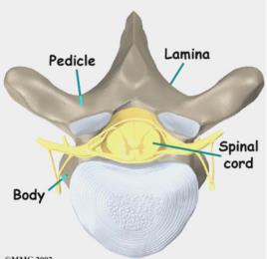
Anatomy- Dermatomes

Slide 6
Thoracic Spine Pathology
Common radiological terms
Spondylosis: (aka osteoarthritis) refers to degenerative changes of the spinal stuctures )discs, facets, vertebral bodies). Very vague term and number one source of non surgical back pain
Spondylolisthesis: Refers to slippage of one vertebrae over another. Can be forward (antero) or posterior (retro) and is graded I-IV being I the mildest. Several etiologies.
Foraminal stenosis: stricture of the foramen from where nerve roots exit the spine, leads to radiculopathy.
Central canal stenosis: thoracic leads to compression of the spinal cord (myelopathy). Can be due to bulging discs, facet hypertrophy, osteophytes and/or thickened ligamentum flavum, tumors, abscess, fractures, hematoma

Slide 7
Thoracic Spine Pathology
Common radiological terms
Scoliosis: refers to curvature of the spine (> 10 degrees Cobb angle). Most common in adults is degenerative.
Myelomalacia: refers to spinal cord signal changes on MRI. Usually represents contusions of the spinal cord
Syringomyelia: cystic formation within the spinal cord
Disc dessication: aged disc, doesn’t imply stenosis of any kind

Slide 8
Thoracic Spine Pathology
Congenital
Degenerative
Trauma
Tumor
Infection
Inflammatory
Vascular

Slide 9
Thoracic Spine Pathology
Congenital
  Scoliosis
  Dyastematomyelia
  Spinal stenosis (epidural lipomatosis, short pedicle syndrome)
  Dysraphism (dermoid cyst)
  Tethered spinal cord

Slide 10
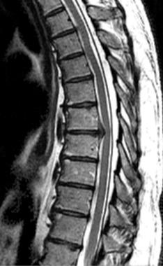
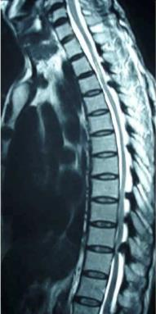
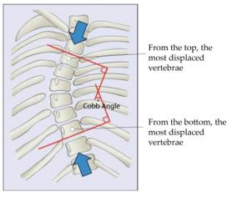
Thoracic Spine Pathology
Degenerative
    Scoliosis
    Stenosis

Slide 11
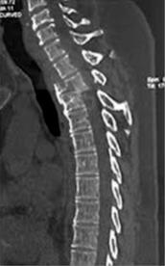
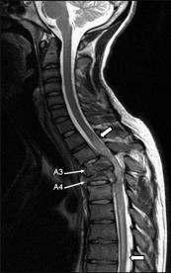
Thoracic Spine Pathology
Trauma
  Fractures
  Subluxations
  Compression
  Scoliosis

Slide 12
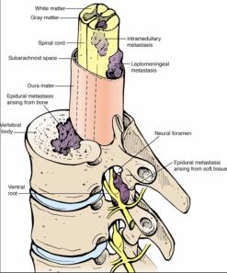
Thoracic Spine Pathology
Tumor
  Primary vs. metastatic
  Epidural vs. intradural
  Intramedullary vs. extramedullary

Slide 13
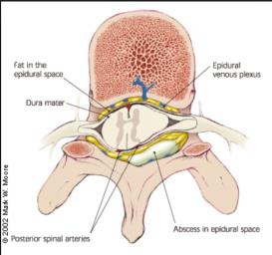
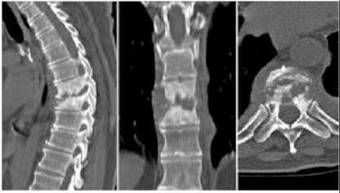
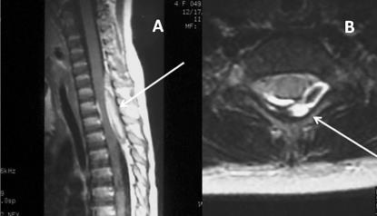
Thoracic Spine Pathology
Infection
  Discitis
  Osteomyellitis
  Epidural abscess

Slide 14
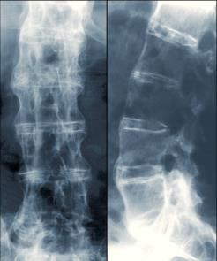
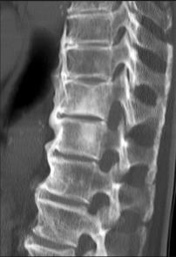
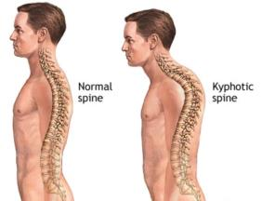
Thoracic Spine Pathology
Inflammatory
  Hyperkyphosis (Scheuermann’s kyphosis)
  Ankylosing spondylitis
  Rheumatoid arthritis
  DISH
  OPLL

Slide 15
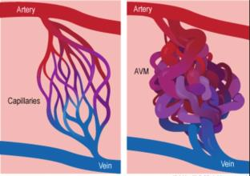
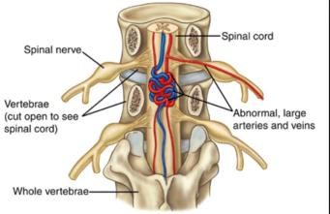
Thoracic Spine Pathology
Vascular
  Dural A-V fistula
  Arterio-venous malformations
  Spinal infarct

Slide 16
Thoracic Spine Pathology
Treatment options
Congenital bracing-surgery
Degenerative PT-Pain Management-Surgery
Trauma bracing- surgery
Tumor XRT- chemo- surgery
Infection Abx- surgery
Inflammatory Immunotherapy-PT-surgery
Vascular embolization-XRT-surgery

Slide 17
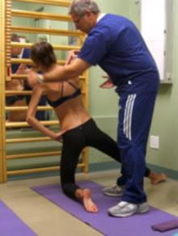
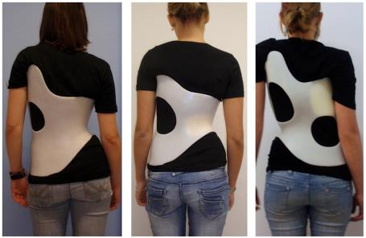
  Conservative options:
    Multimodal pain management
    Physical therapy
    Bracing

Slide 18
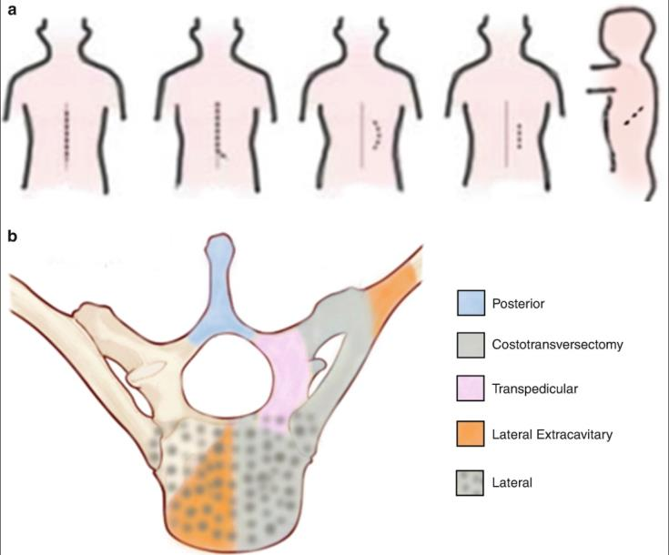
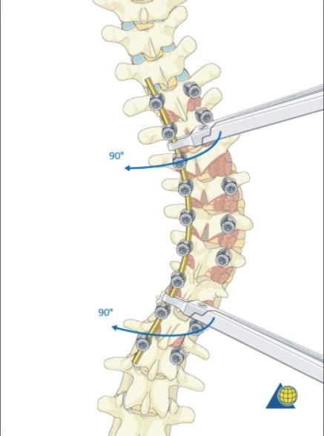
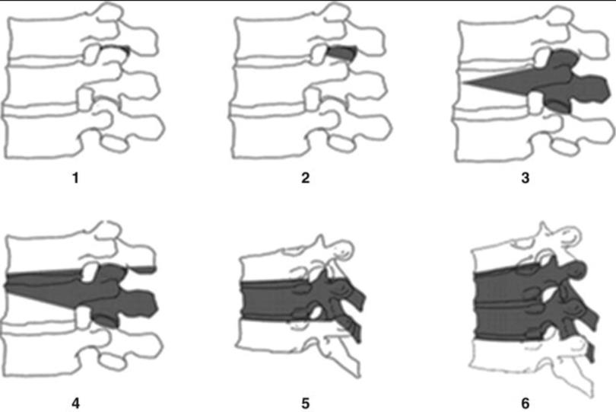
Thoracic pathology surgical options
Surgical tools include: hooks, wiring, bands, screws, rods, cages, spacers
Surgical techniques include:
Laminectomies, corpectomies,
Osteotomy : Ponte, Smith-Peterson, Pedicle substraction, Vertebral body resection
Rod manipulation: derotation, cantilever, in situ bending

Slide 19
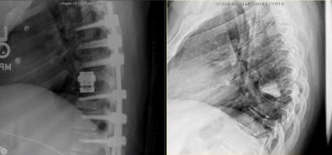
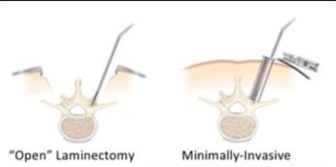
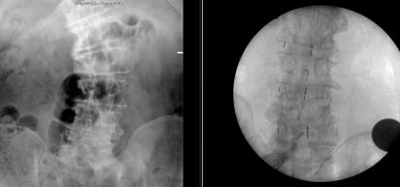
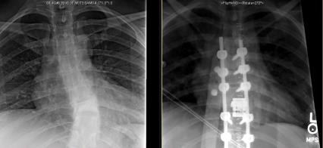
Thoracic pathology treatment
  Surgical options:
    Focal decompression
    Short segment stabilization
    Deformity correction

Slide 20
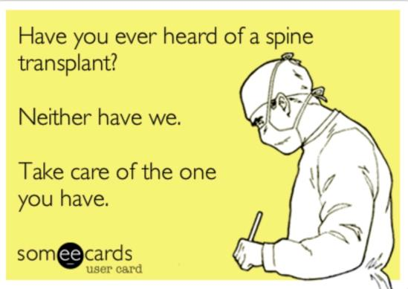
            THANKS

